Slide 1

https://www.uni-goettingen.de/en/48115.html
UNPLAB-BrMeth_Ch11[GP/GS] Chapter 11 of <Breeding Method> with Genomic Prediction aka Genomic Selection
1

Slide 2
Sequential Number: #29
UNPLAB-BrMeth_Ch-11[TheFour GS]
Unless I explicitly state otherwise, images and cartoons are created using ChatGPT.
You may use this material free of charge under the terms of the CC BY license. This requires that you provide appropriate attribution to the author: W. Link, University of Goettingen, Germany.
In a few cases, individual images, photographs, or similar material may be subject to a more restrictive Creative Commons license. Where this applies, it is explicitly indicated, and you must comply with the stated license terms for those items.
Please check the license information carefully before reuse. Responsibility for complying with the applicable license terms rests entirely with you.
2

Slide 3
You already know:
Population Genetics. Genotype frequency, Allele frequency, Hardy-Weinberg-Equilibrium, Inbreeding coefficient, Kinship, Selection, Drift, Migration, Mutation. GxE, stability of performance, Heritability.
And you have already studied Recurrent Selection (that already gave you a good feeling for what Methodology is, yet, in Recurrent Selection which is Pre-Breeding, Vorlaufzüchtung).
You already have seen the pertinent Selection Method in Line Breeding plus Maintenance Breeding plus Backcrossing as approach in Line Breeding.
Keywords of this chapter: Genomic Prediction, Genomic Selection, Prediction Model, Genomic Estimated Breeding Value, Predictive Ability, Accuracy, Training, Validation, estimated effect size. GWAS, Marker Score.
Algebra as introduced in this chapter: none
Compared to my traditional curriculum, this chapter is an insertion, an addition; to better stay on the ball with the current modernization and the foreseeable development in Plant Breeding
3

Slide 4
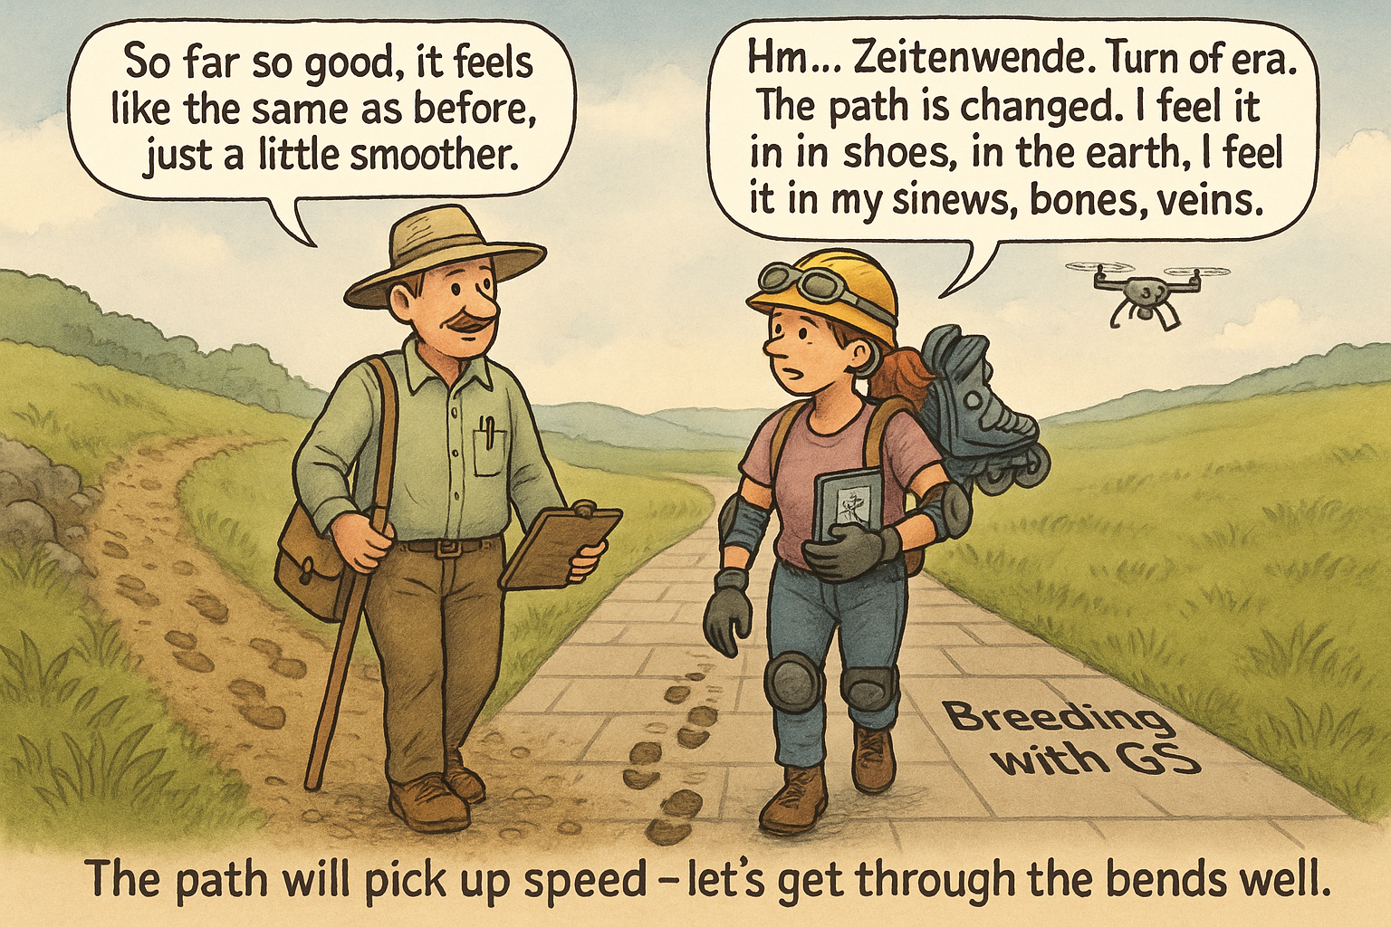
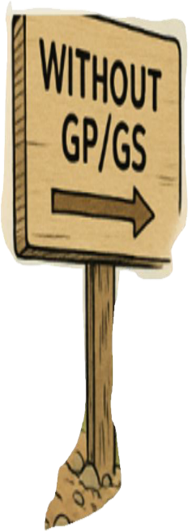
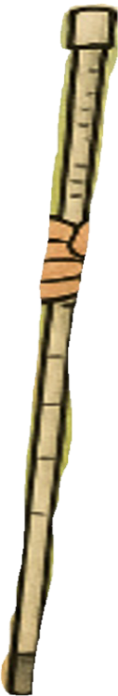


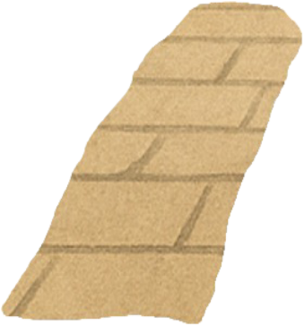

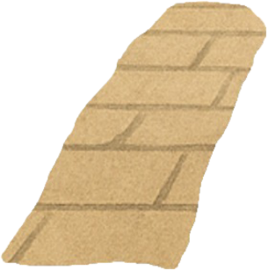
4
looks
I tell you, this is a very different path, you‘ll feel it in your shows and sinews. This path will pick up speed! Go quickly so that you don't lose touch straight away ;-)
Will GS really change the way we breed plants in a disruptive manner?
Rather than working a bit more on the PC and a bit less in the field; instead of being somewhat more efficient …
will it bring a fold-change or even
… will it destroy the value of the exper-tise of todays breeders?
With ChatGPT
J. Rutkoski, 2021 (UIUC Spring Workshop): “GS is a disruptive breeding technology - it will change how the breeding program operates if done correctly”.

Slide 5
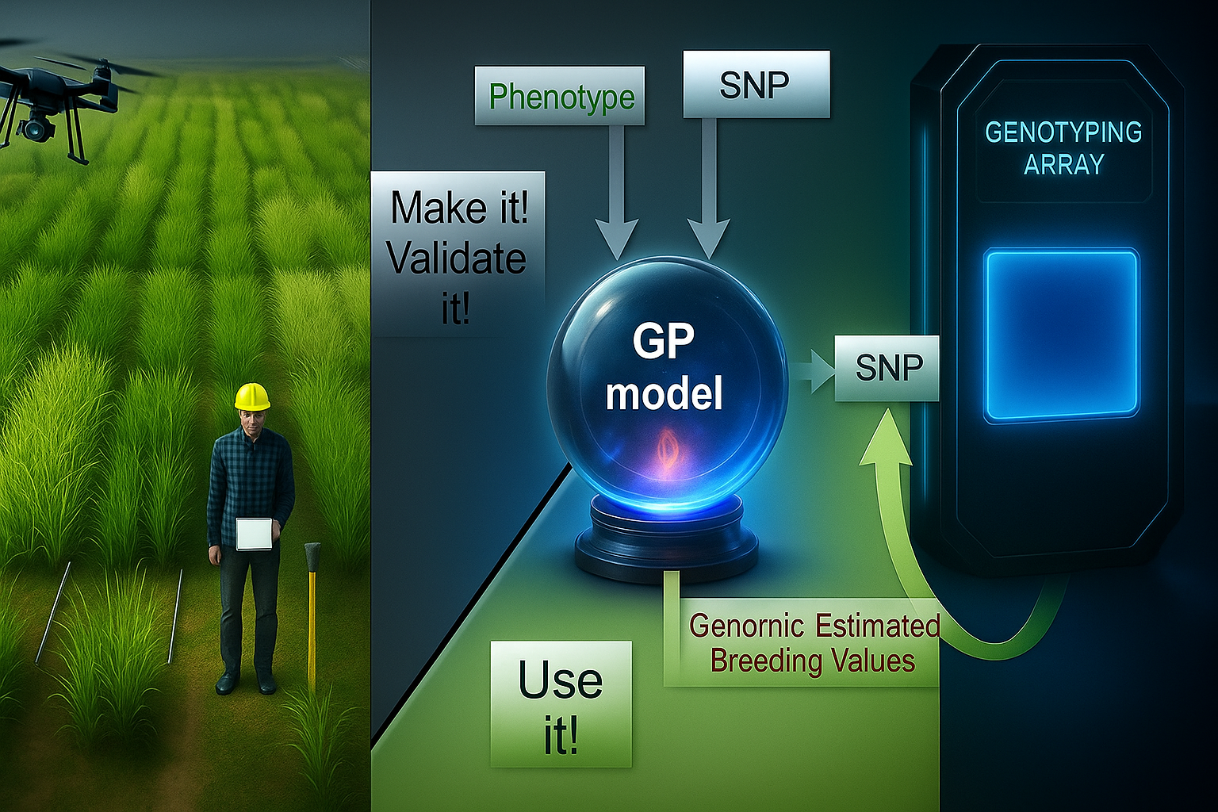








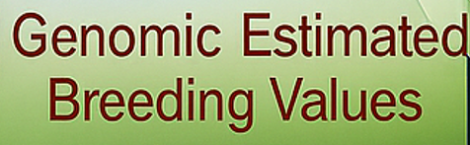
2025
SNP
2026
2027
Assessment of phenotypic data as basis for Selection and Breeding
2028
2029
2030
2031
2032
2033
2034
2035
2036
2037
Genomic Estimated Breeding Values
2038
2039
...
5

Slide 6
6
2025
SNP
2026
2027
Assessment of phenotypic data as basis for Selection and Breeding
2028
2029
2030
2031
2032
2033
2034
2035
2036
2037
Genomic Estimated Breeding Values
2038
2039
Genomic Selection as additional tool for more
efficient Selection and Plant Breeding

Slide 7
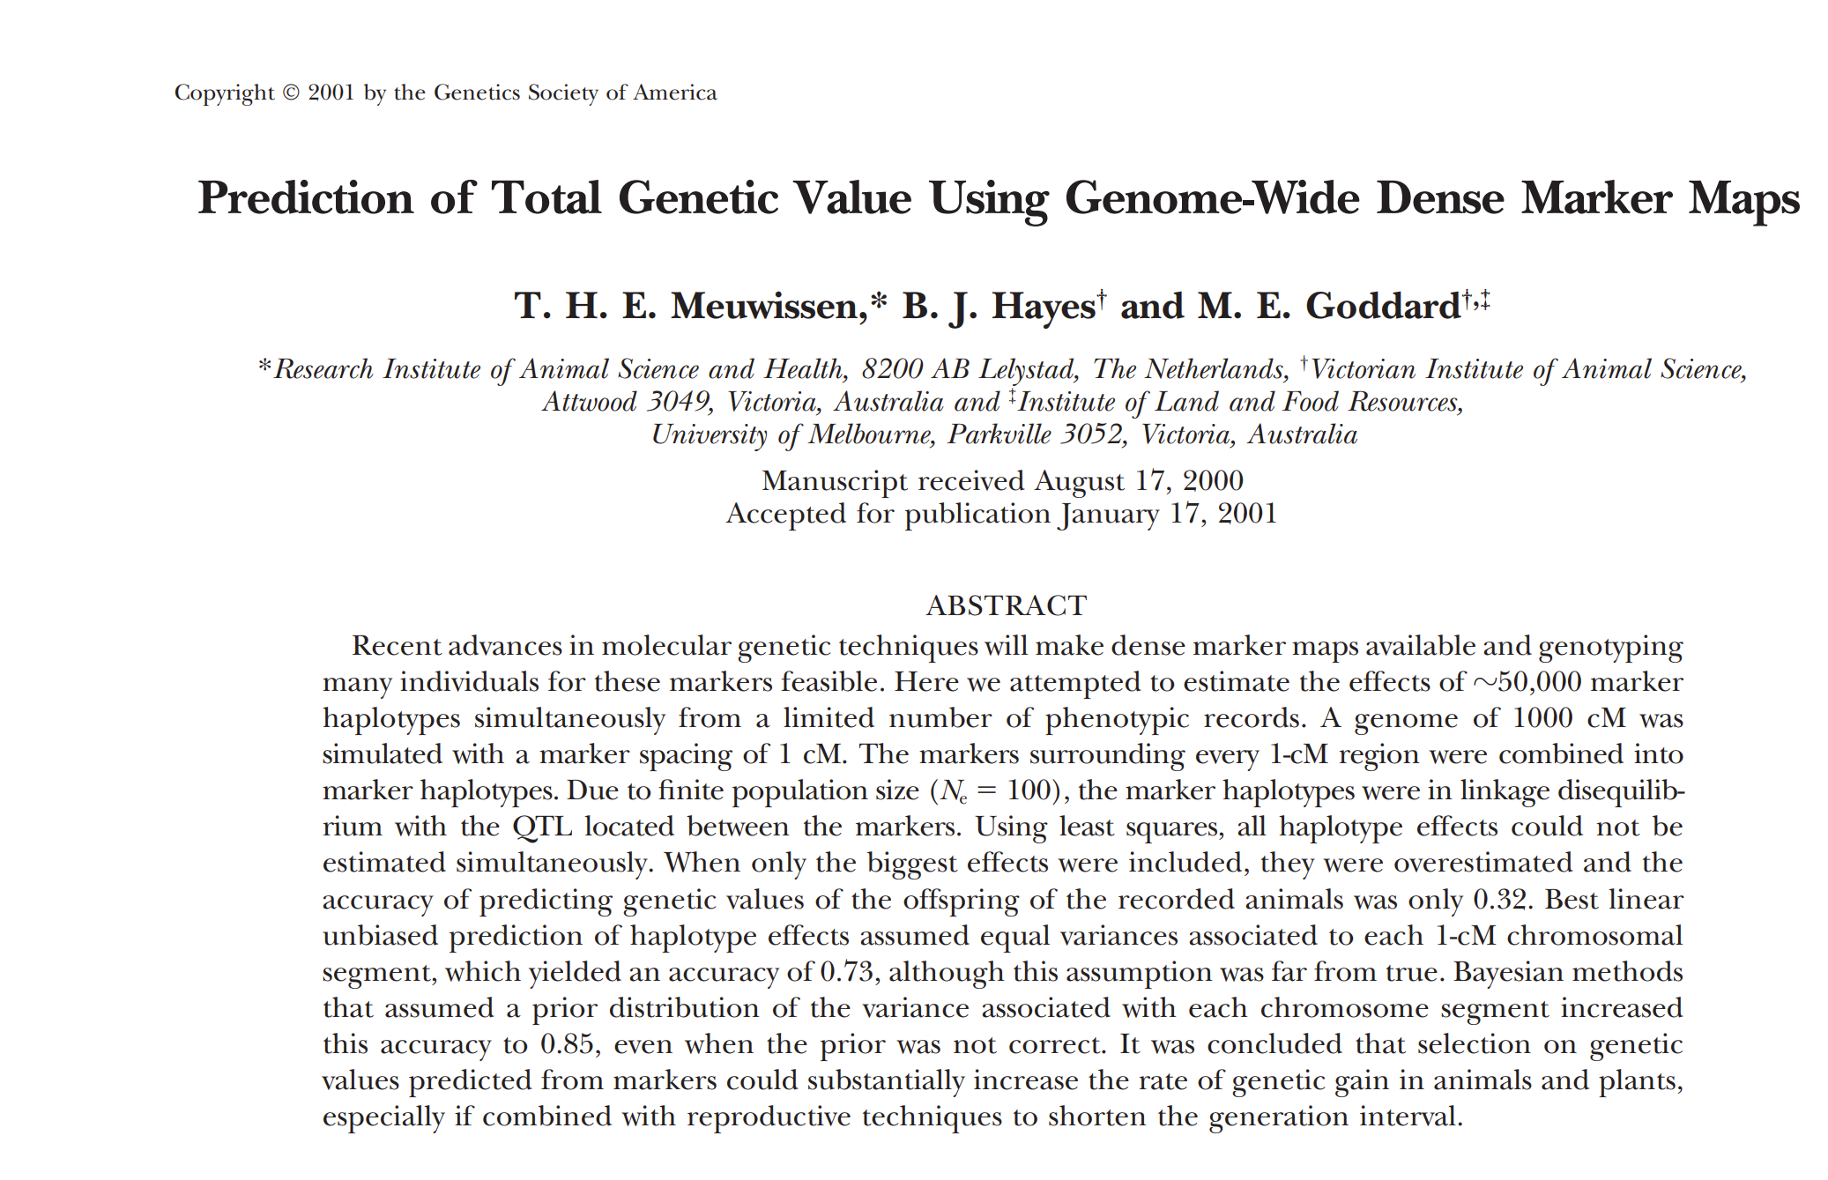
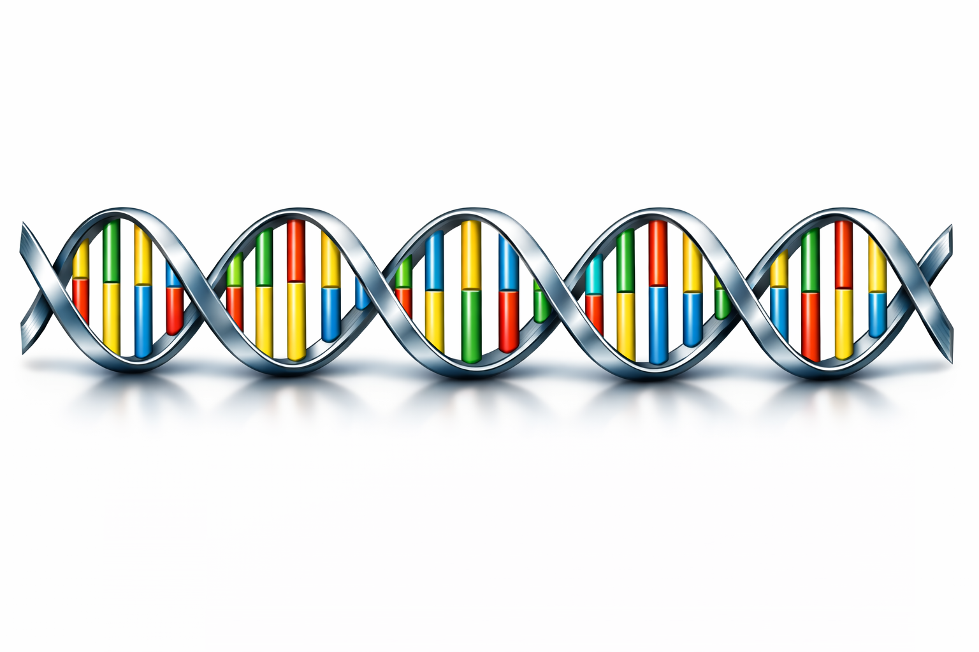
Indeed, first in Animal Breeding and since about 2010 in Plant Breeding, selection is increasingly conducted based on DNA-data instead of on phenotypic data alone.
That approach comes as
‘Genomic Prediction’ aka ‘Genomic Selection’
https://doi.org/10.1080/15427528.2011.558767
With the increasingly prominent employment of DNA-Markers (for kinship analyses, for analysis of inbreeding status, for marker-assisted selection in its various guises; and many purposes more), we see a list of important terms … I will and cannot explain all of them here. However, you already know many of them, or others are yet to come here.
Terms: DNA Chip (e.g. Axiom), GBS (Genotyping by Sequencing), SPET (Single Primer Enrichment Technology), Imputation, Minor Allele Frequency,
Marker Density, Calibration, Training Population, Model, Population Structure, LD Decay, Breeding Population, Test Population, Validation, Verifica-tion, Genomic Estimated Breeding Value, Predic-tive Ability, Predictive Accuracy, Ridge Regres-sion, Ridge Regression BLUP, G-BLUP, Bayes Alphabet, Machine Learning. Shrinkage Methods. There are – of course – more of them. You can barely avoid to meet them.
‘Genomic Prediction’ aka ‘Genomic Selection’
With ChatGPT. It does not ‘know’ about 4 bases and pairing between purines (A, G) and pyrimidines (C, T). Do you?
7

Slide 8
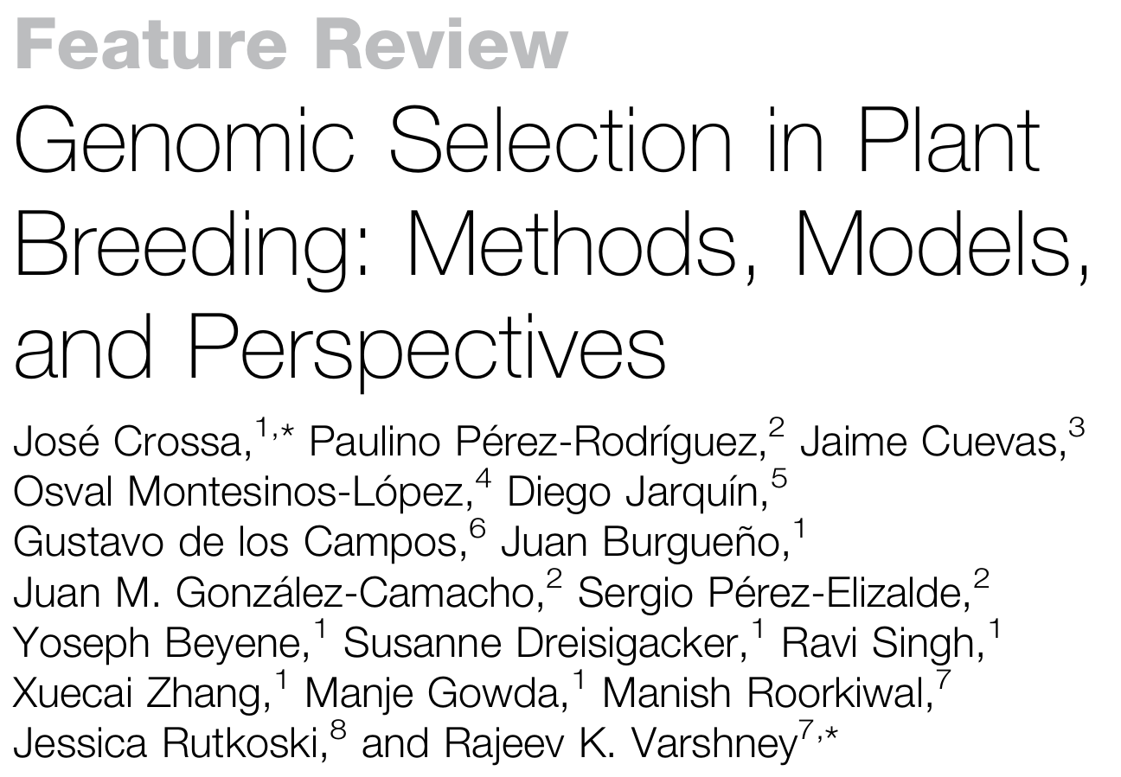
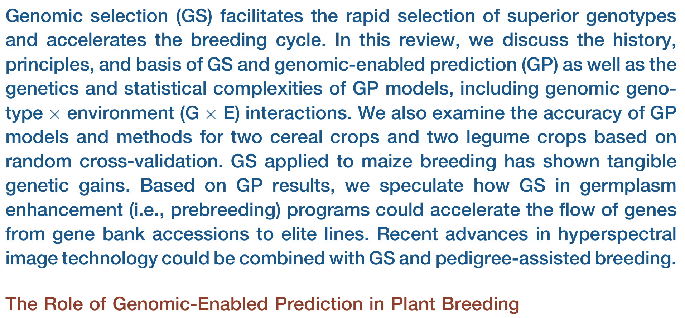
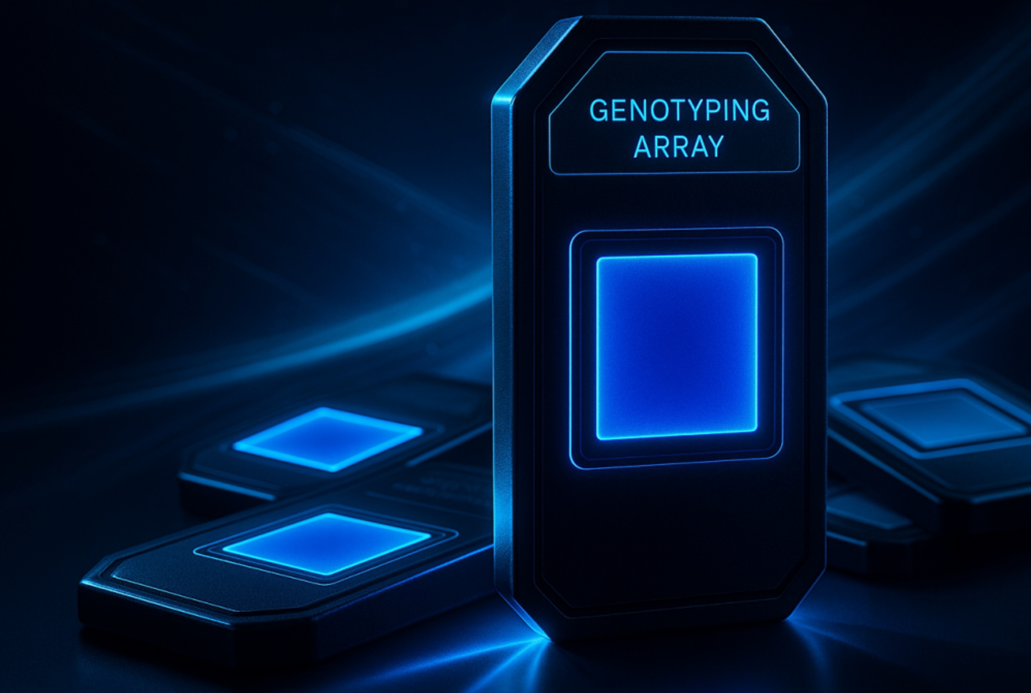
‘Genomic Prediction’ aka ‘Genomic Selection’.
Reflecting on this very important development led me to list the following terms, topics and areas that became relevant for my work yet I came across them only after I had finished my studies and doctorate.
8
Crossa et al., Trends in Plant Science, 2017, Vol.22, no.11
Terms: DNA-markers (RFLP, RAPD, AFLP, SSR, SNP); codominant and dominant marker, Bulked Segregant Analysis, Linkage Mapping; bi-parental QTL analysis, Fine-Mapping; Distance-LD-heterosis-intra-inter-pool; Genetic Distance parameters (Rogers‘, Modified Rogers‘, Nei, Dice, Jaccard, Simple Matching, vanRaden); AMMI-Analysis; NIRS (Calibration-Validation); Reverse Breeding; Synteny & Gene Annotations; Micro-Array, Axiom-SNP-Chip, GBS; SPET, KASP-Analysis; Golden Gate, Pyro-Sequencing, Nested Association Mapping, MAGIC, GWAS, Tassel GLM, MML, map- and effect-based version of ‚Usefulness of Crosses‘. The list is of course not complete. A current big thing is for some time now Genomic Prediction and Ge-nomic Selection, sometimes combined with single-plant-based Recurrent Selection and Breeding. Beyond predict-ting the Breeding Values or Genotypic Value of candidates, approaches are under development to predict their value in specific environments: dry vs. moist, soil type, latitude-altitude, types of biotic-abiotic stress ... Thrilling times ;-)

Slide 9
Genomic Prediction (GP) and Genomic Selection GS) may bring about a soft transition into a slightly different strategy of Plant Breeding - but it could also bring about a strong, violent change; we'll see.
There is some similarity between GP/GS (yield and other traits) and NIRS*-based ‚prediction‘ (traits such as grain protein content).
NIRS goes in two steps. (1) Create the Calibration Equation and validate it;
(2) Apply the calibration equation.
GP/GS goes in two steps. (1) Create the Prediction Model and validate it;
(2) Apply the prediction model.
*Near Infrared Spectroscopy; this parallelism even caused a NIRS based version of prediction, nowadays called ‘Phenomic Prediction’, see for instance DOI 10.1007/s00122-021-03997-7
9

Slide 10
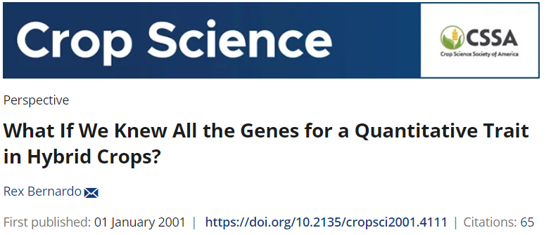
What if we perfectly knew all - say - 4 loci and their alleles ‘of’ our trait? And if we knew the effect of their alleles, and the 4-locus-genotypes of all of our candidates!?
►Then we would conduct ‘perfect*’ selection based the genetic values G.
Loci ► |  | 1 | 2 | 3 | 4 | G-Value
Candidates | #1 | + | +/- | + | - | 2.5
 | #2 | - | + | - | +/- | 1.5
 | #3 | - | +/- | + | - | 1.5
 | #4 | - | - | - | + | 1.0
Candidate #1 is selected because it is homozygous for the favourable allele “+” at 2 out of 4 loci and in addition heterozygous at one. Some loci are more important than others? - we neglect this ;-). None of the other candidates is that ‘good’.
Well, in a more sophisticated setting we would understand that candidate #4 has the favourable allele at the 4th locus – which candidate #1 is missing. We may keep #4 … :-) ... for further breeding.
*Perfect? Well. Selection is based on genetic information about the candidates, say on „Total-Genetic-Value-based Selection“ instead of „Phenotype-based Selection“. The current version of this is called „Genomic Selection“. Estimates of the G-Values are termed ‚ ‘Genomic-Estimated-Breeding Value’ or ‘G.-E.-Genetic Value’.
10

Slide 11
If we follow a monogenic or oligogenic trait (1 or few loci) – then we will kind-of directly select the ‘better’ genotypes as soon as we see their genotypic data.
Say: Trait is a quality compound; the higher values are the better ones.
Locus 1 AA vs. TT; Locus 2 AA vs. TT; Locus 3 CC vs. GG; Locus 4 TT vs. AA.
Locus 1 effect: 90 Locus 2 effect: 25 Locus 3 effect: 2.5 Locus 1 effect: 70
‚Bad‘ alleles are in red (they contribute 0 to the desired quality compound)
Let us see two specific ►candidates (see their alleles at loci #1-#4).
#1 #2 #3 #4
► AA TT GG TT Joint Score is 160 (90+ 0+ 0+70)
► TT AA CC AA Joint Score is 27.5 ( 0+25+2.5+ 0)
Easy to see which of the two candidates is better: Locus 1 and 4 are much more important to ‚have‘ than locus 2 and locus 3. It is nearly unnecessary to calculate a Joint Marker Score. Yet, the more loci involved, the more we need it.
We here admit that the impact of loci in trait may differ, you see the point!
11

Slide 12
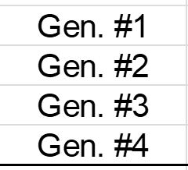
In most cases, the impact of loci on genetic variation of trait will differ. Alors ….
Impacts of the four loci will not be the same. How to get info about their effects-on-trait?
We estimate (calculate) effects of these four SNP by joining genetic and trait data.
We assume ‘causative’ SNP: Simplistic setting (cf. https://s.gwdg.de/y1fFO3; DOI: 10.1093/genetics/157.4.1819).
Estimation of effects at four SNP. The AA status at SNP1 is coded as 1, TT status as 0. At SNP2, AT-heterozygosity occurs, coded as 0.5. At SNP3, GG may be coded as 1; et cetera. Of course you remember from your maths A-level how to determine four un-knowns with four equations. You see that having at SNP1 AA instead of TT has a marked increasing effect of the trait expression (phenotypic value), the impact is w=90. SNP 3 has a very small effect. Genotype #4 realized its trait value of 70 with zero contribution from SNP1, SNP2, SNP3 and with z=70.
With these SNP-effects: w, x, y, z, one then can esti-mate (anticipate, predict, calculate) the trait expression of further, so-far not yet phenotyped genotypes.
Such genotype could be AA/TT/CC/TT, for instance.
AA
TT
TT
TT
12

Slide 13
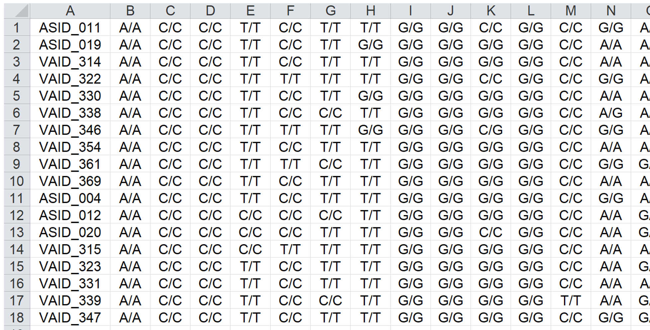
Application: Employ estimates at four SNP and predict performance of a so-far un-tested (un-phenotyped) candidate.
A so-far non-phenotyped candidate #5 shows these SNP (results from ‘genotyping’):
Cand. #5 shows ► SNP1 SNP2 SNP3 SNP4
AA TT CC TT
Coded then as ► 1 0 0 1
Effects then ► 90 0 0 70
Consequently, its Joint Score (estimated performance) is Y=90+0+0+70 = 160. .. a highly promising type!
Ceci ce n'est qu'un accessoire visuel
13

Slide 14
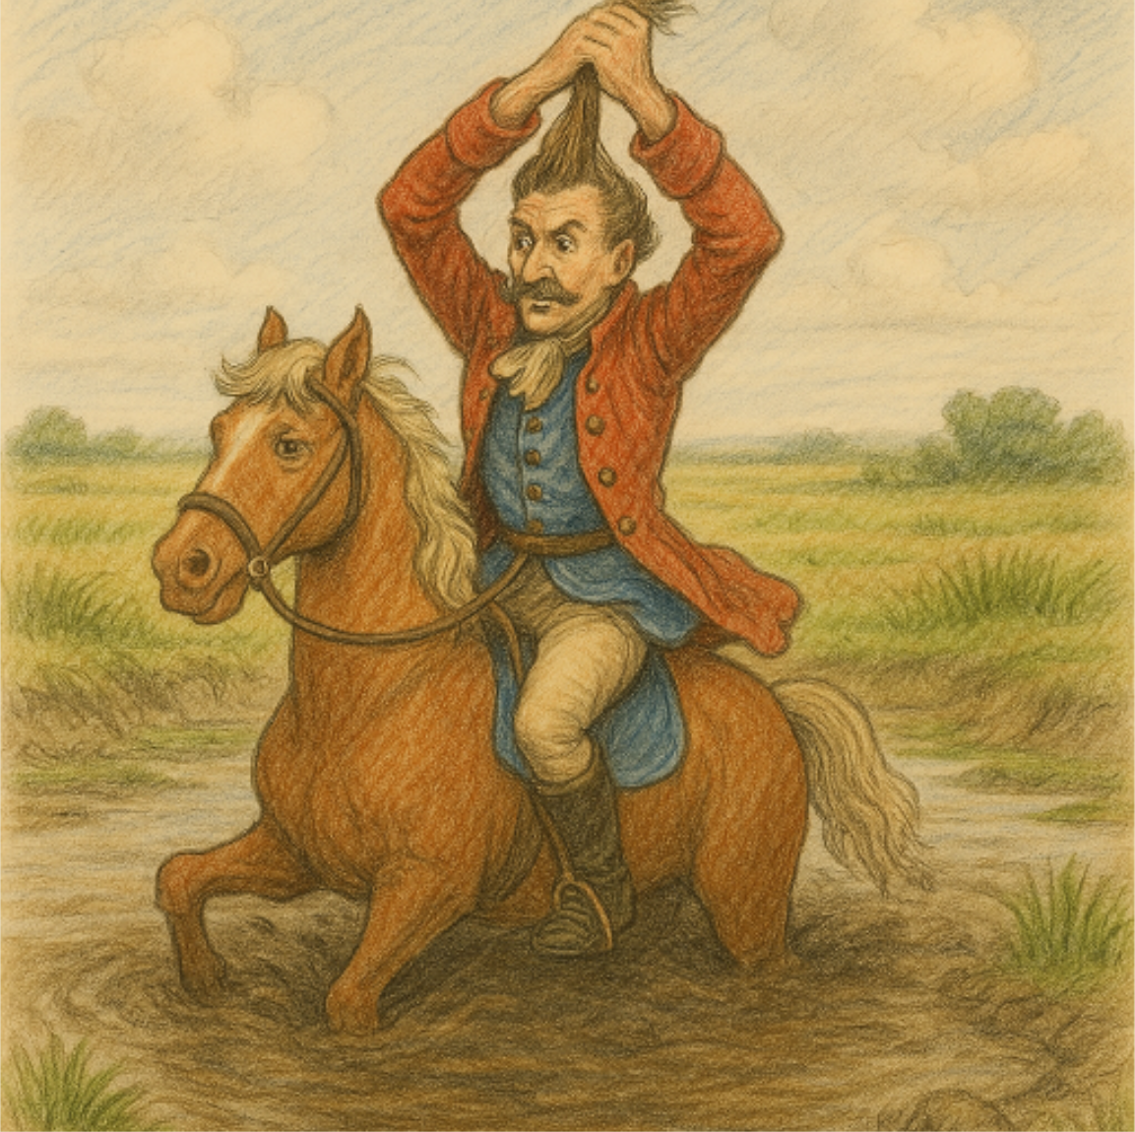
14
The notorious Baron von Münchhausen pulls himself (and his horse) out of the swamp by ‘just’ pulling himself up by his own mop of hair.

Slide 15
If we now have data on the effect of these four important loci, then we can predict the trait expression of non-phenotyped candidates from their genetic status at these loci. Still: How to know which loci are worth-wile to assess their effect on the trait?
15
The notorious Baron von Münchhausen pulls himself (and his horse) out of the swamp by ‘just’ pulling himself up by his own mop of hair.
We have a number of issues here. For our so-far approach, we need to know which loci are the important ones. Only after knowing this we can join genetic data on these loci with trait data and estimate their effect. Again: We need a strategy to find out which loci are of interest and only then estimate their effect. Moreover: We would rather like to employ many genotypes, not only four. Altogether, in our simple case, 16 genotypes are possible. 1-1-1-1; 1-1-1-0; 1-1-0-1; 1-1-0-0; etc. until … 0-0-0-0. We would try to have them all 16, even it were only for reasons of completeness and orthogonality. Then, with 16 equations to estimate 4 unknown variables, what to do?
Of course, we would run linear multiple regression analysis. The resulting coefficient for our loci would be, of course, w=90; x= 25; y= -2,5; z= 70
(hm ... if no phenotyping error and further issues occurred).
linear multiple regression
Moreover: We estimate these effects in a specific germplasm and specific environments. The genetic background will influence the effects of these four loci (epistasis). Their effect may be different in a different gene pool (the same for different environments). We must validate the estimates in independent material and experiments, to not fall in a trap: Circular reasoning; Overfitting; see Münchhausen ;-) DOI 10.3389/fpls.2021.734512.

Slide 16
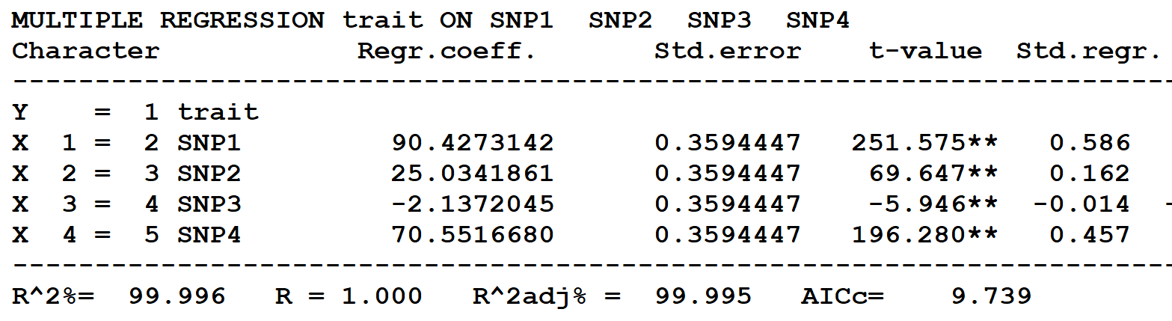
Multiple linear regression analysis. We employ now all 16 possible genotypes and estimate the effects of these four loci on our trait.
16
The multiple regression explains the phenotypic data by R² = 100% - this is because there was no error involved.
The multiple regression explains the phenotypic data by R² = 99.996% < 100% - this is because now a tiny bit of random error was added – see it by comparison.

Slide 17
In ‚reality‘, there are not 4 or 16 genotypes with 4 markers. There are rather 200 or 1000 genotypes (with phenotypic values) and such as 10.000 or 100.000 SNP markers.
A much-much higher number P of marker effects have to be estimated than the number N of equations available. We had P=N=4 or P<N (4<16). In reality, we are confronted with P>N, with the “large P and small N problem”. In such case, linear multiple regression is impossible. So ... ‘Mission Impossible’?
No. With - say - 188 genotypes, you can for each SNP locus conduct an uni-variate linear regression, one by one, one for each SNP, even if the number of markers is higher than the number of genotypes (P>N). This is rough, approximate, yet: Doable. You sort your 188 lines according to whether they carry the one or the other allele at the focal SNP. Then see whether the two groups’ means differ for the trait. I write it again so that you read it again! You sort your panel of homozygous lines in two groups, one with (say) T at the focal SNP and the other with (say) G. If these two groups were (significantly) different for their mean trait value, then you have a (significant) association between that SNP‘s segregation and the trait. Then, that SNP marks a putative QTL. The difference ‘is’ the SNP’s effect.
You can do this very many times, even if the number of SNP is very large, therefore even „large P and small N“ allow you to estimate effects. Still: Which SNP should we analyze-and-employ? Instead of looking for a reply you just avoid that question, you decide: „We analyze all available SNP“. And yes, indeed, this makes P>>N. This is what the team of Meuwissen decided to do as “Genomic Prediction”. Indeed, just take them all (‘winner takes it all’).
Algebra that is employed is called ‘Regularization of SNP marker effects’, it overcome this P>N issue. Tim Beissinger uses ‘Shrinkage Methods’ as generic term for these approaches; DOI: 10.1534/genetics.113.151753;
DOI: 10.1007/s11032-021-01203-6.
17

Slide 18
Ali et al. (2016) did it just like ‚everybody‘ ... they ‚just‘ grouped their N=188 inbred lines according to each SNP and checked 1322 a priori unsuspicious SNP (like this one).
One of the 1322 DNA-markers
AGGTAGCCATTGAARAATACTTCRAGCCTCTTGACAASGAGGCTGAGTTTTTAATG
AAAATGCAACTARAAGGGGAAGAGAAAACTTCGGAGATGATGAT[T/G]AAAGCACTACAGGAACAAGCTATGCGGCGACAAGCTGAAGCAGAAAAANGTACAAGTGTTCATC
AAACAGAAAGTGTTGAAACCAACCAGAAGGAA
Well, it was slightly less primitive: TASSEL 3.0 and MLM was employed. Result of this grouping was: 20 inbred lines happened to show T:T (homozygous-T); 168 showed G:G. The average phenotypic value for the T:T group was higher (more loss of turgor and colour after artificial freezing test), and the G:G group seemed more freezing tole-rant (value 34.90). That marker seemingly ‘contributes’, with its G-allele, favourably to freezing tolerance. This approach was a so-called GWAS (see below), only the significant (~stronger) SNPs are pursued further.
This ‚group-the-material-according-to-the-focal-SNP‘ and ‚check-whether-a-pheno-typic-difference-between-the-two-groups- exists‘ is repeated for each marker. Eight of the 1322 markers here were ‚significant‘.
60
N=20
N=168
50
SNP: VfMt3g086600
Effect: 5.7; R²: 0.083
40.58
Loss of Turgor/Colour; Score
40
34.90
18
30
T:T-Genotypes
G:G-Genotypes
20
Ali et al., 2016. Crop Science 56, 1036-1048

Slide 19
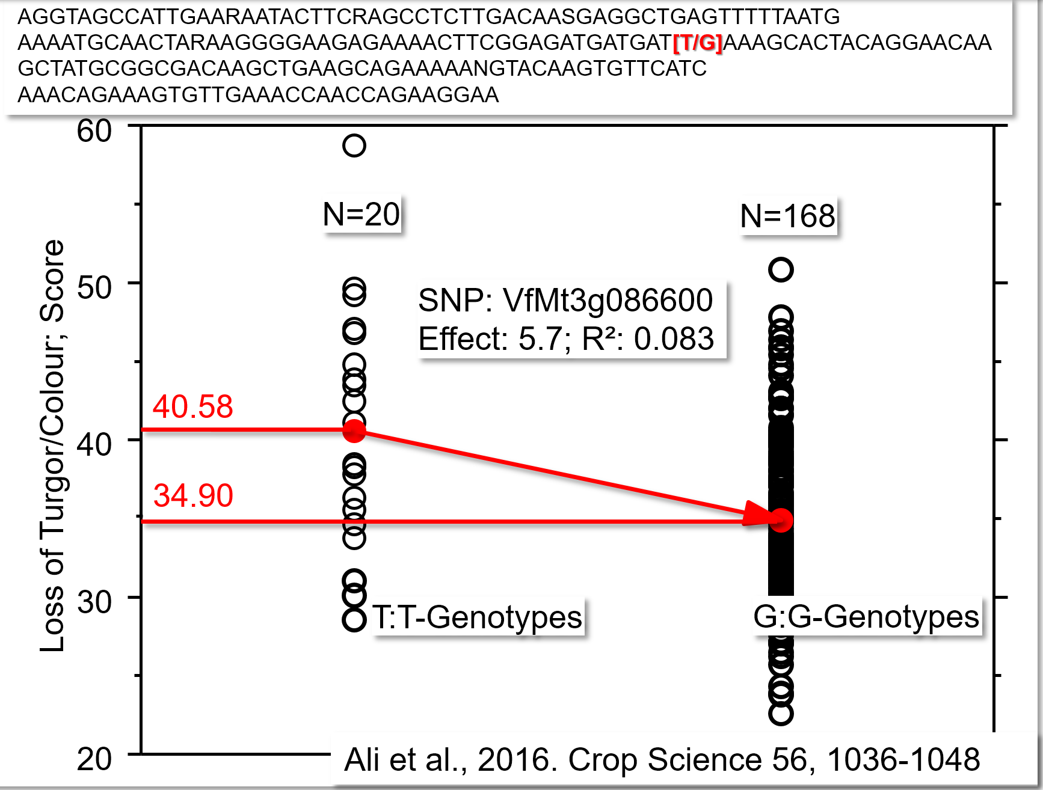
P>>N, never mind. Ruthlessly we repeat the procedure P times. We ‘ask’ each SNP whether and to what extent it could be associated with a phenotypic group-difference.
Although the number of inbred lines was – in this case – only N=188, and the number of DNA-markers was P=1322, it worked: Just repeat the procedure 1322 times ;-) ... once per marker; no problem. Really? Eight DNA-markers were found with significant association to freezing tole-rance. It is inconceivable that the 20 T:T lines and the 168 G:G show the same frequency of alleles for the seven other markers. Especially with group size of only 20, that will not be true. So: Such groups will some-what differ in background locis’ genotype.
This is unfortunate! If the QTL background of the two groups differ, then the group contrast is not a ‚clean‘ estimate of the focal SNP effect. Hm ...
Statistical models and approaches are used to estimate the effects of either
few, significant DNA-markers along with ‚their’ QTL (so-called GWAS) or to estimate the effect of
all, hence very many DNA-markers effect without significance test (so-called Genomic Prediction).
In the one way or in the other way - you add up each candidate’s estimated effects to its ‘Marker Score’ or its Estimated ‘Genetic Value’. These approaches are meanwhile sophisticated and diverse. They come under names such as MLM, FarmCPU, BLINK; and as Ridge Regression BLUP or as Bayesian algorithms and more. Machine learning approaches are of course employed, too – you anticipated this, didn’t you ;-).
19

Slide 20
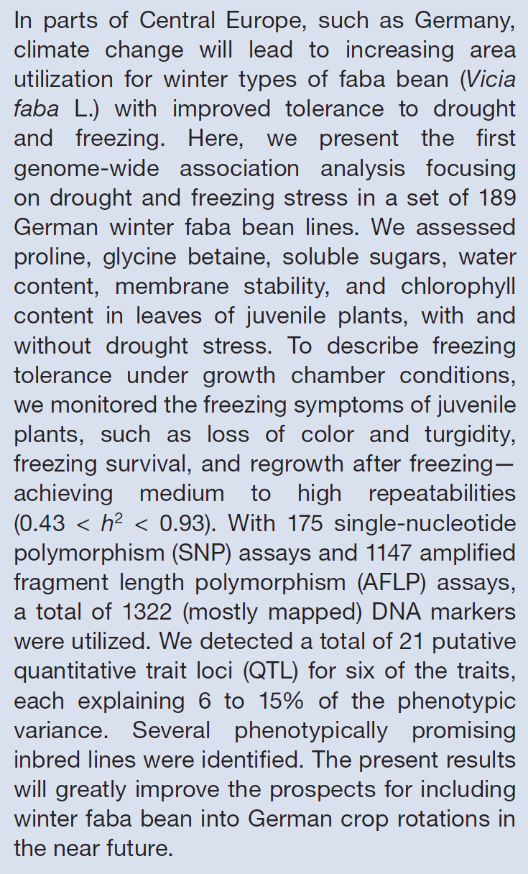
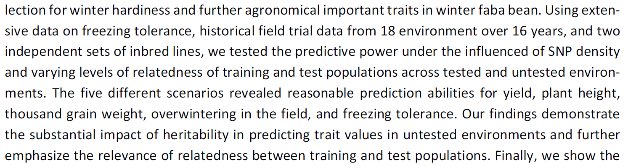
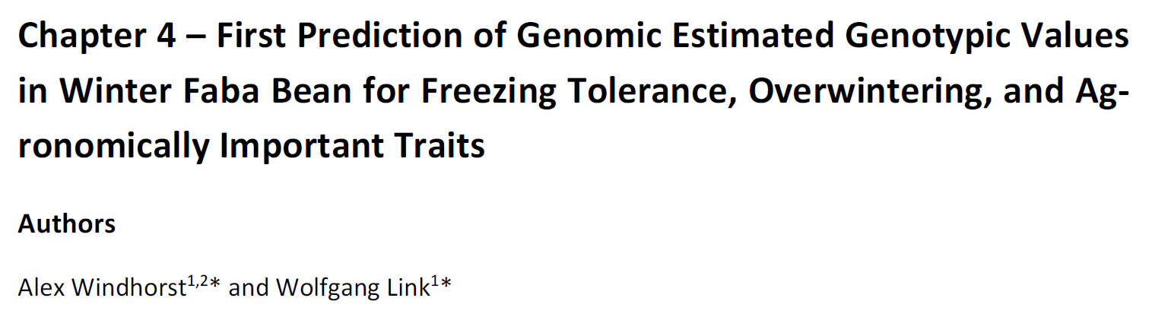
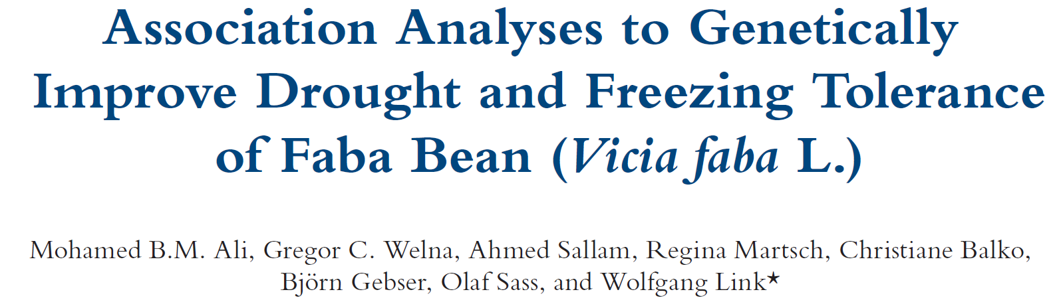
Two related approaches to conduct Marker-Assisted Selection.
1 Genome-Wide Association study (GWAS).
Find significant QTL’ effect.
Select according to ‚Marker Score‘.
Find candidate genes.
2 Genomic Prediction (GP) and Genomic Selection (GS).
Estimate the effect of all SNP, whether zero, minimal, decent or even large. Exploit information from a so-called Genomic Relatedness Matrix.
Employ ‚Total Genetic Value‘ aka ‘Genomic Estimated Breeding Value’ for Selection.
2016. Crop Science
1036-1048
20
Windhorst, 2024. PhD thesis

Slide 21

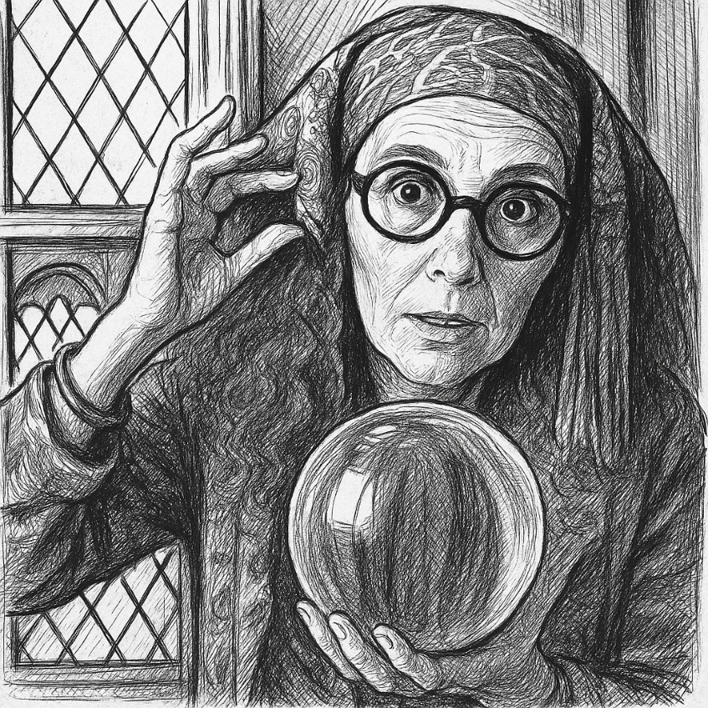
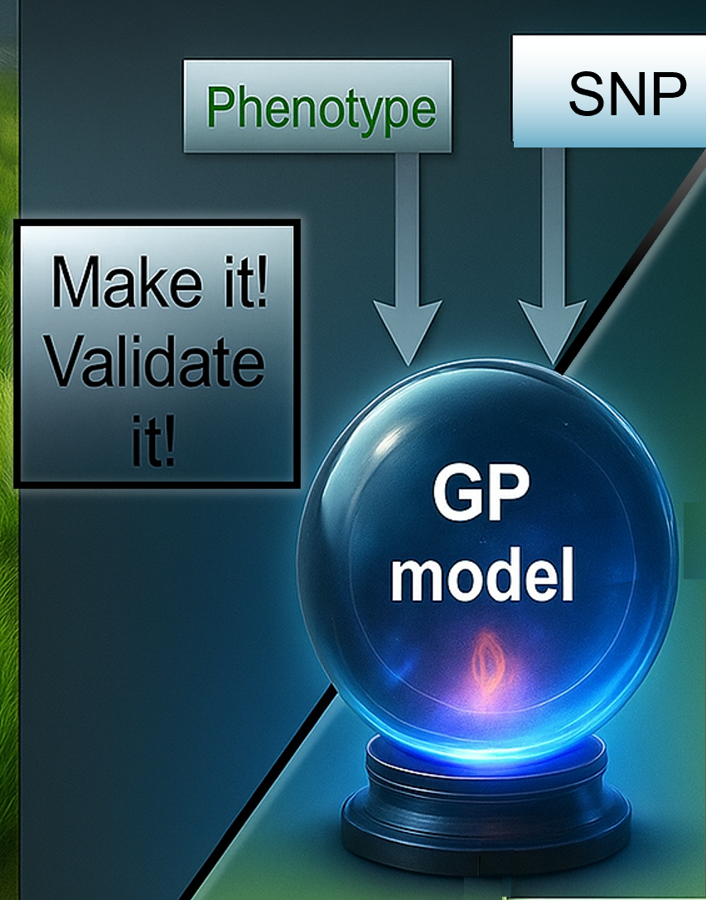
The logical flow - focus now on Genomic Prediction: First: Create the ‘model’ (algorithm, crystal-bowl Algebra). You join phenotypic and DNA-data (SNP data) and make the crystal bowl ‚learn‘ how associate the DNA polymorphisms with trait variation (e.g. GBLUP; rrBLUP; R package Endelmann 2011). This is called ‘Training’.
Employ a Training panel of genotypes (Training Population), assess their phenotypic data and their DNA data.
21

Slide 22
The logical flow - focus on Genomic Prediction: First, to create the ‘model’ (algorithm, crystal-bowl algebra). You join phenotypic and DNA-data (SNP data,) and make the crystal bowl ‚learn‘ how associate the DNA polymorphisms with trait variation (e.g. GBLUP; rrBLUP R package Endelmann 2011). This is called ‘Training’.
Which and how many genotypes for assessing their phenotypic and DNA-marker data? How to acquire high-value phenotypic data? Genetic breadth, elite-level, LD pattern, inbreeding status etc. of candidates of the Training Population? Type of marker (SNP, haplotypes …), technique to score DNA-markers, pipeline to ‚clean‘ phenotypic and marker data? Necessary or optimum number of markers? How to treat missing data? Distribution of markers along genetic map or along physical map? How to integrate the validation steps into the training? Regular, maybe frequent re-training of the created ‚Model‘? Where in your breeding scheme to employ the GP Model? Change your breeding scheme to allow a better, cheaper, earlier, … employment of Genomic Selection? Which traits are more apt for traditional phenotype based breeding and which are more apt for GS? Add your own question here ...
There is more than enough four you to invest your ambition and time into it!
22

Slide 23
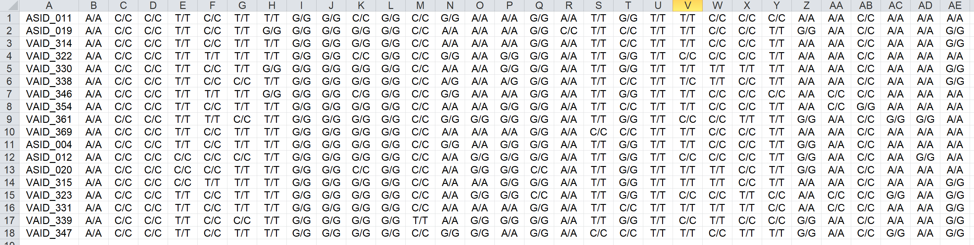
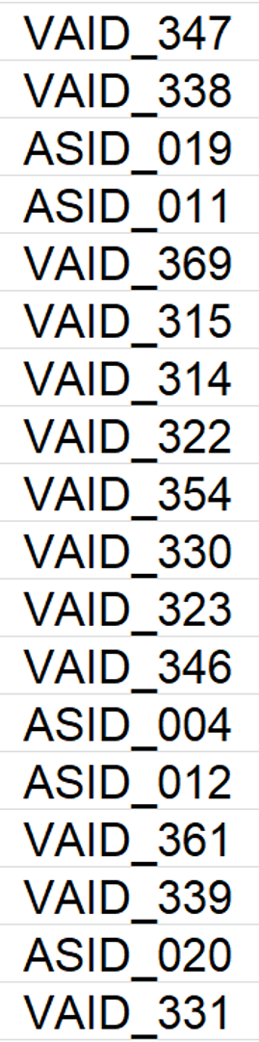
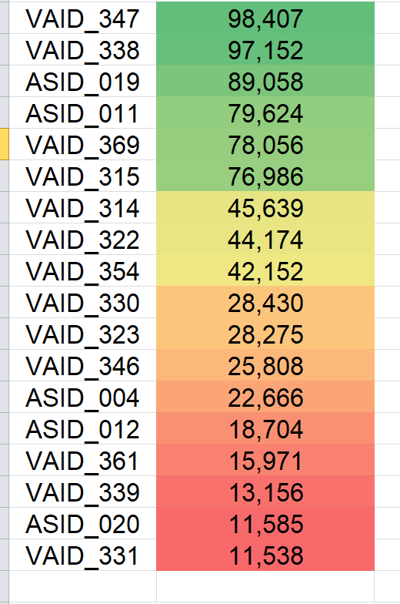
The logical flow - focus now on Genomic Prediction: First, to create the ‘model’ (algorithm, black-box algebra). You join phenotypic and DNA-data (SNP data,) and make the crystal bowl ‚learn‘ to associate the DNA polymorphisms with trait variation (e.g. GBLUP; rrBLUP R package Endelmann 2011). This is called ‘Training’.
Of course you need phenotypic data of high quality (h²) and a set of genotypes that displays marked genetic variation for the trait of interest and which is related to the target breeding germplasm – or which indeed itself is the target breeding germplasm.
For Training, it is rele-vant to have the ‚bad‘ types included, although the breeder abhors in-vestment into bad types ;-)
DNA-data (SNP; aka ‘genotypes’)
Training Candidates
Pheno-typic data
Pheno-
typic trait
data
Learning / Training / Calibration
23

Slide 24
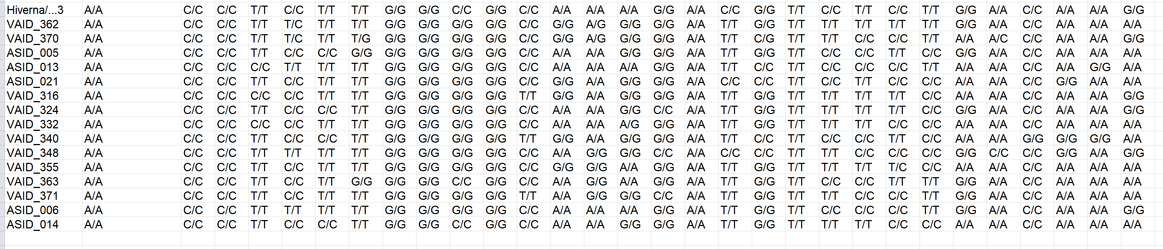
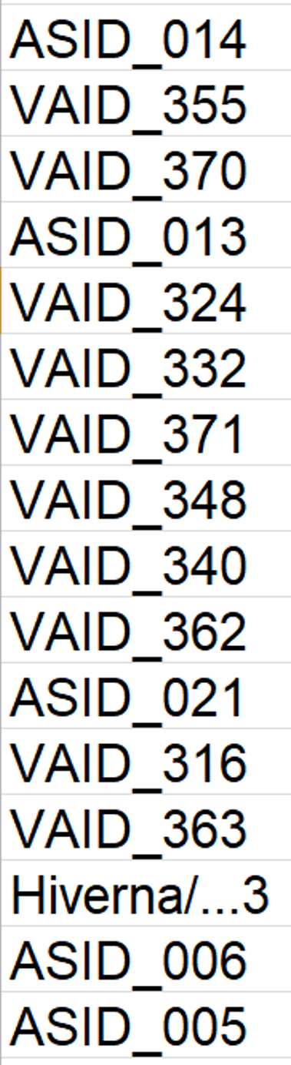
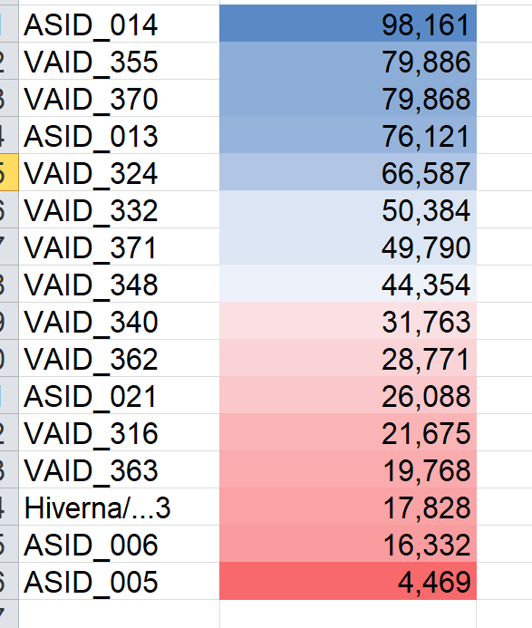
The logical flow of this approach. Second: The trained Model is applied. You feed DNA-data of phenotypically unknown candidates and get back estimates (predictions) of their performance in the focal trait. Estimates are usually not very precise. Yet ....
... you can predict and hence select as soon as the new candidates give DNA - even if candidates exist only as (immature) seed. If they survive the DNA-donation, you can focus on the (predicted) best ones. Sow only them. No need to sow all candidates; no waiting for e.g. their offspring’s performance in repli-cated field plots.
This haste-making side is the strong side of Genomic Selection.
New DNA- data (SNP)
= new genotypes
Candidates for your selection
Trait values are predictions
Application
Application of the whole thing
24

Slide 25
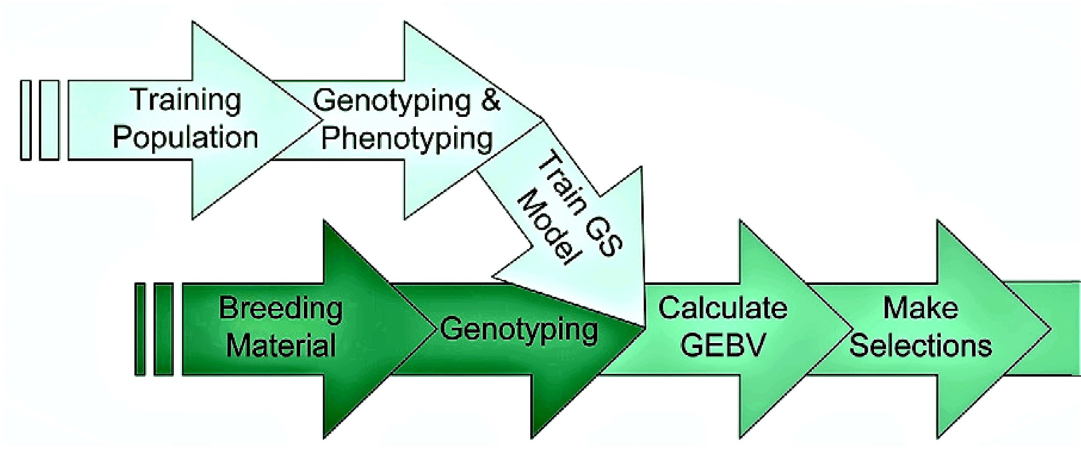
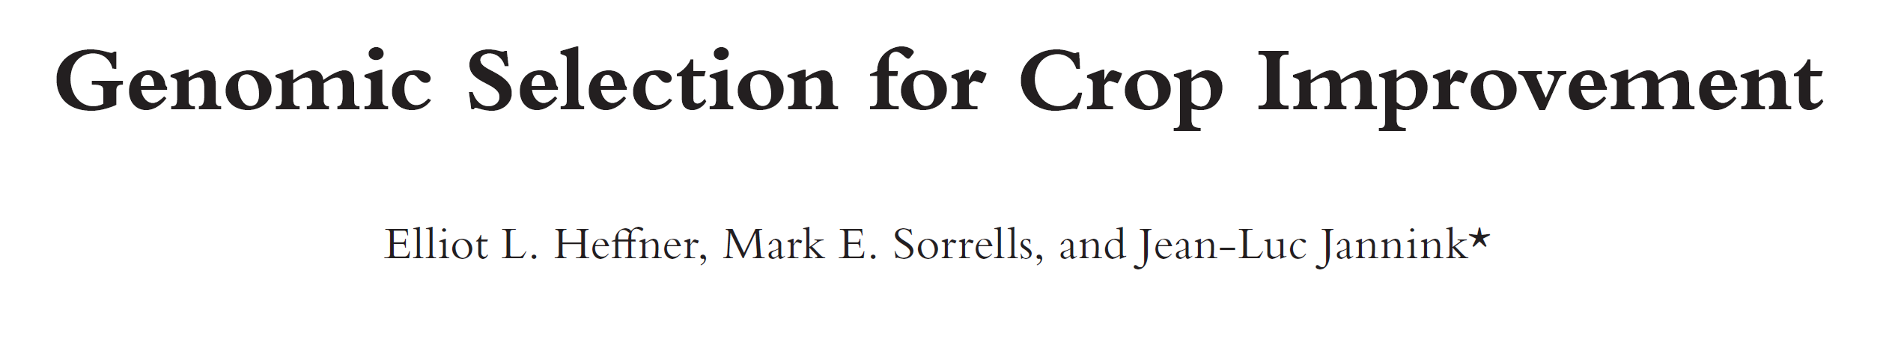
Ultra-famous flow chart, illustrating Genomic Selection (in Plant and Animal Breeding)
Obviously, there is a Training Population of genotypes and there is the ordinary Breeding Material. The Training Population of genotypes is used to Make a Genomic-Selection Model: With its DNA data (many thousands of SNP per genotype) and with data from trait assessment (phenotypic data). This means to construct Algebra and Algorithm for GP (Genomic Prediction). This step corresponds to the making-of-the-calibration in NIRS-analyses.
The GP Model then is used to calculate from DNA-data only the so-called predictions (estimates) of the trait data of candidates (genotypes of the Breeding Material). Again: The GP Model plus SNP data of untested candidates suffice to predict trait values (performances) of these untested candidates. Such predicted values are then called GEBV (Genomic Estimated Breeding Value) or GEGV (Genomic Estimated Genetic Value).
GEBV or GEGV are used for selection. So, again: Select between candidates without ‘really’ testing them ;-)
2009
25

Slide 26
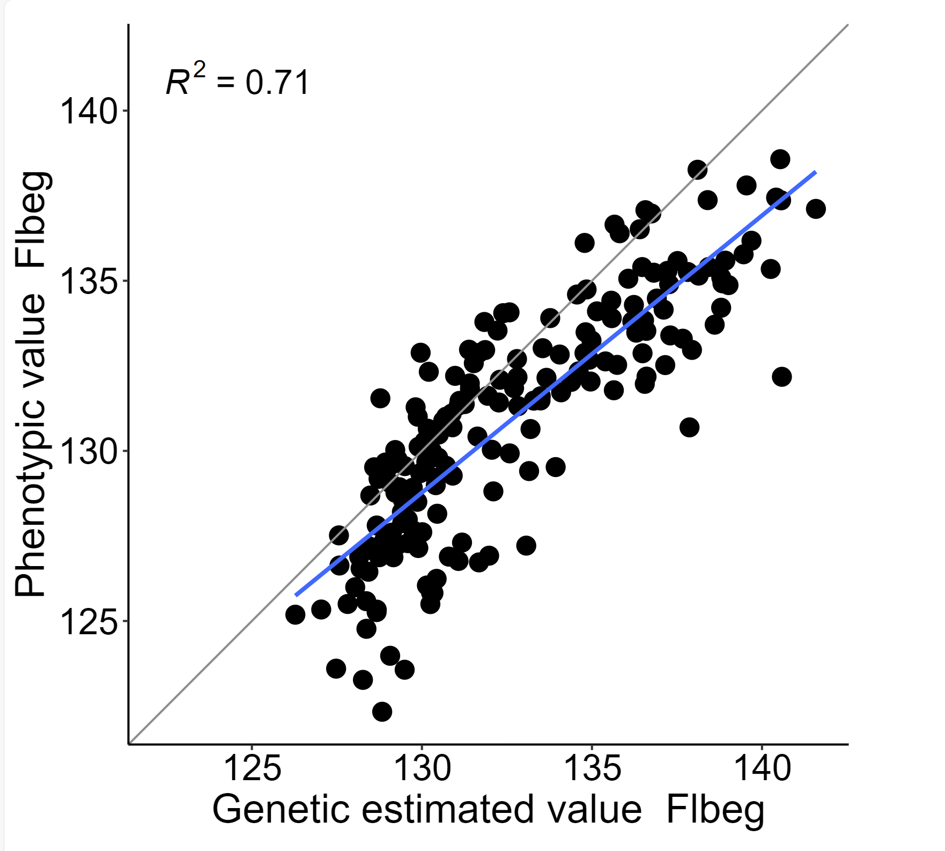
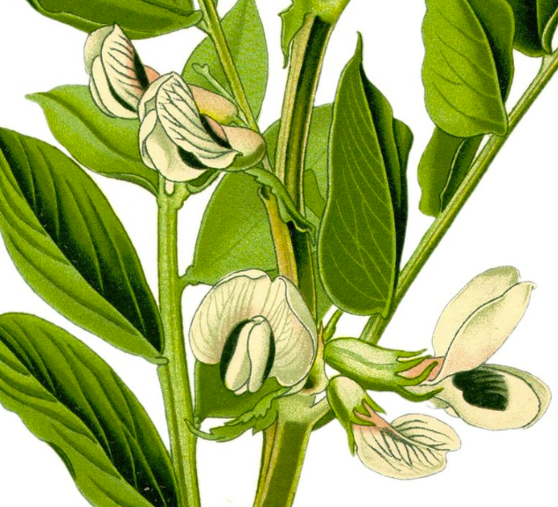
Genomic Selection (begin of flowering of winter faba bean).
X-axis: Genomically predicted performance (flowering time)
Y-axis: Phenotypic data from outcrossed offspring (to validate the ‘predictive ability’ of the model).
Windhorst and Link 2024, Poster 21, GPZ Geisenheim
Y-axis
X-axis: Data to train the model was from N=185 inbred lines tested in 11 field traits (between 2005 and 2022; Göttingen). Predictions are displayed on X-axis.
Y-axis: Data to validate the Model (the Genomic Predicted results) was from ex-trial seed from the same inbred lines tested in another 7 environments (between 2006 and 2021, Göttingen).
Ex-trial seed of each inbred lines contains about 70-90% seed of the inbred line itself and about 10-30% hybrid seed, with any of the other 184 inbred lines as pollinator. Shares of such hybrids in offspring (Y-axis) are unknown and depend on genotype and season.
In breeding application, one would of course, when applying the model, not predict candidates that are al-ready phenotyped. This is done here for validation!
r=0.84
Begin of flowering, offspring
Thomé, 1885
26
Genomic prediction for begin of flowering (days)

Slide 27
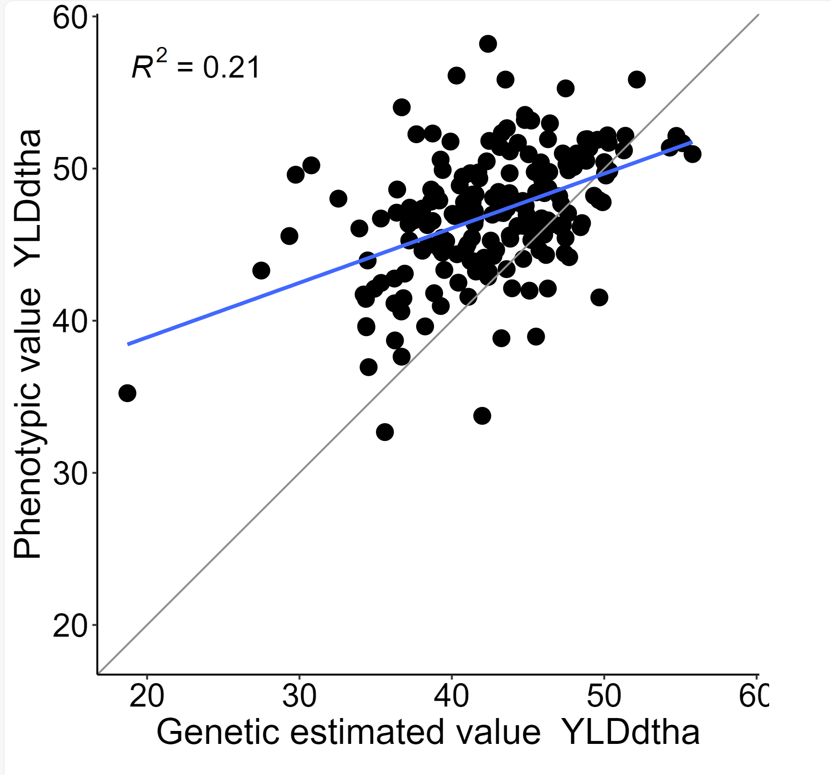
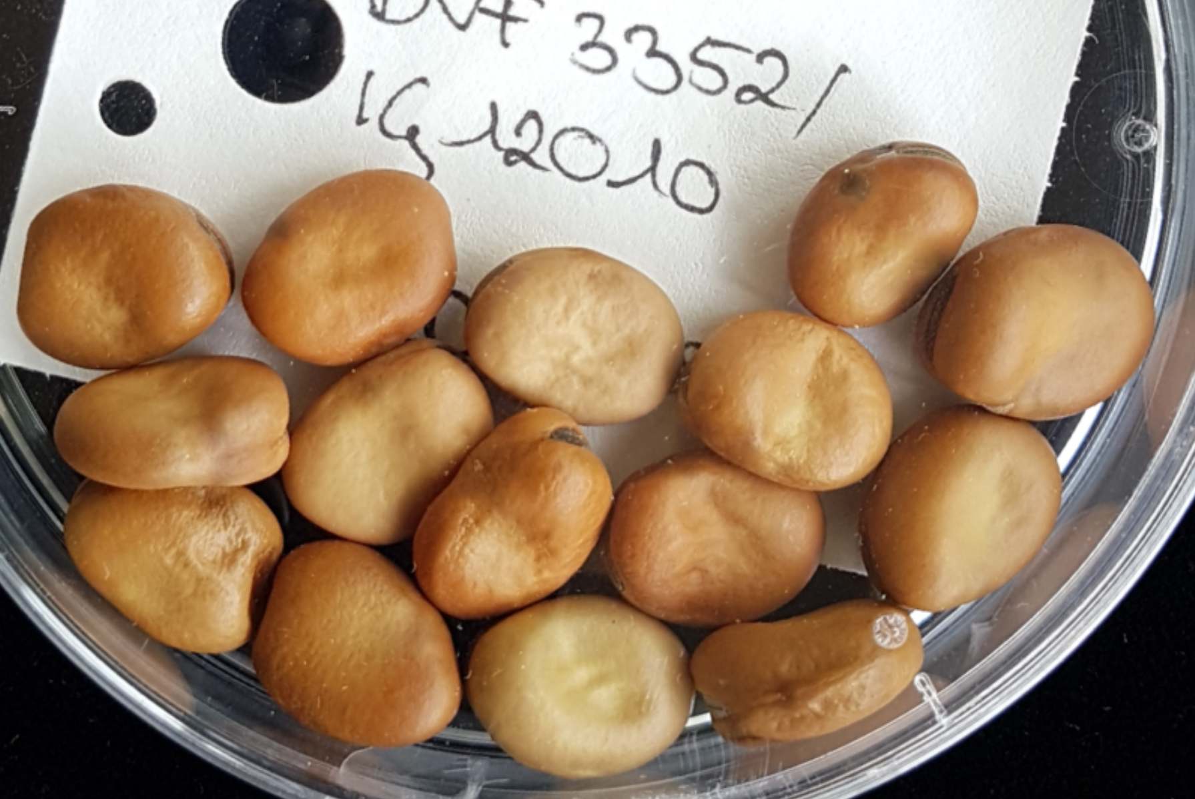
Genomic Prediction (begin of flowering and grain yield of winter faba bean).
X-axis: Genomically predicted performance (trained from inbred lines results, E=11)
Y-axis: Data from outcrossed offspring (further E=7; to validate the prediction).
27
Windhorst and Link 2024, Poster 21, GPZ Geisenheim
Y-axis
Y-axis
Begin of flowering, offspring
Grain yield, offspring
Thomé, 1885
© Windhorst
Genomic prediction for begin of flowering (days)
Genomic prediction for grain yield (dt/ha)

Slide 28
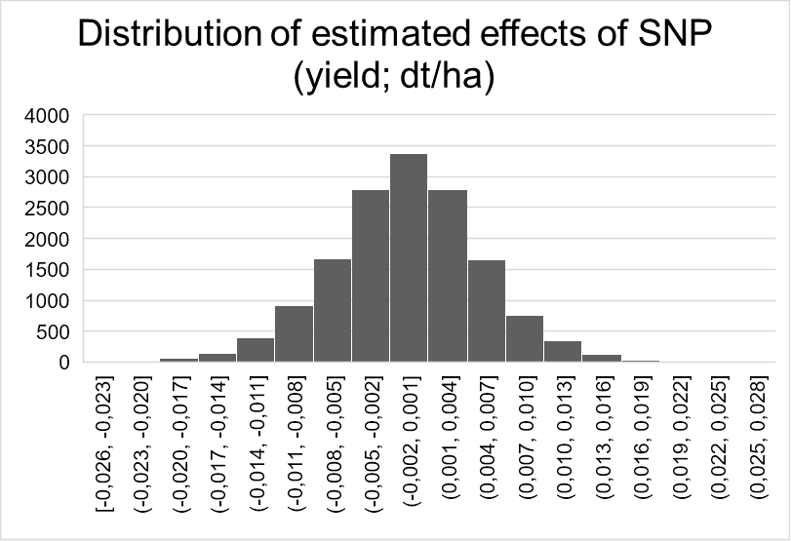
Genomic Prediction is not mainly useful to find the ‚best‘ one – here the best one (Y-axis) is, admittedly, no member of the superior-predicted 50% (X-axis).
Yet, Genomic Prediction can save money and time.
Yield of inbred lines‘ progenies
Distribution of estimated effects of 15078 SNP on grain yield (dt/ha)
Grain yield, offspring
Estimates of inbred lines‘ yield from GS model
Genomic prediction for grain yield (dt/ha)
28

Slide 29
Genomic Prediction is not mainly useful to find the ‚best‘ one – here the best one (Y-axis) is, admittedly, no member of the superior 50%
(X-axis).
Yet, Genomic Prediction can make you save money and time.
Grain yield, offspring
Yield of inbred lines‘ progenies
© Windhorst
Estimates of inbred lines‘ yield from GS model
Genomic prediction for grain yield (dt/ha)
29

Slide 30

Once we have a GP model, we need to train and re-train it. Marker-allele and QTL-allele frequencies change due to our selection. Marker-QTL-LD will decay because of recombination. Migration/Mutation/Drift … may cause further genetic changes. Genetic and Climate change changes effects of QTL on traits (drought tolerance becomes more important et cetera). We must run field trials with most recent genotypes and feed their marker-plus-phenotypic data into the most recent models (re-train them). We should ‘show’ some current yet ‘bad’ candidates to the model as well.
Jessica Rutkoski, 2021 (UIUC Spring Workshop 2021): “The germplasm used
for model training set should be closely related to your selection candidates”.
A widely used statement. Literally it means: “Average kinship of each breeding
candidate with each training candidate should be high”. This would mean that
both groups are genetically narrow. Maximum kinship is if both groups consist
only of one, the same, homozygous genotype. This can not be what is meant.
It is more like “The breeding population should not be many breeding cycles
distant”.
If the breeding population is not (more or less) ‘near’ to the training set, then
Genomic Prediction may, especially for traits such as grain yield, perform
weakly, with low predictive ability (0.0 < r < 0.3). Especially so if the training
set is limited (<1000 entries), if it does not well cover the variance needed
and if h² of data of training set is not high (h² <0.8).
There is obviously room for further improvement! DOI: 10.1007/s12892-024-00234-7;
DOI: 10.1016/j.molp.2024.03.00
Jessica Rutkoski
https://www.youtube.com/@jessicarutkoski1192
30

Slide 31
... It is more like “The breeding population should not be many breeding cycles distant”.
What is meant is rather: “Let the allele frequencies and LD structure in both populations be as similar as possible”. This means: “Let the training population and the breeding germplasm be two representative samples of the same basic pool” – or even “Let the two groups be the same group”. But: Isn’t the honest purpose of a GP/GS model to predict “other” genotypes’ performance (in the same Target Pool of Environments from which the training sites/years were sampled, hopefully representatively). Hm ...
The minimum and optimum number of genotypes and markers in the training population is a further point of investigation. Sure, more sounds better. Strategies to validate with „other“ genotypes in other environments or to – at least – cross-validate are a topic of research. Match of h² and genetic make-up of the trait with the type of Algebra employed to create the model (‘Bayes Alphabet’) is further studied, including machine learning approaches.
„What if“ ... costs for genotyping and phenotyping fall further and much lower, eventually near to zero per data point and candidate? This may cause a major and hard-to predict change in our work.
31

Slide 32
We dramatically change topic
... yet still stay in the same topic ;-)
We abandon the SNP effect based philosophy and instead we take a glimpse of the pedigree-based (aka Genomic Relationship-based*) philosophy of Genomic Prediction.
One consequence of this change is that you do not have to simultaneously solve the very high number P of equations which is dictated by the very high number P of markers - but you ‘only’ solve the high-but-smaller number N of equations which is dictated by the high-but-smaller number of N genotypes (candidates). It is a bit miraculous, admittedly
*we employ this so-called GRM = Genomic Relationship Matrix
32

Slide 33
See families and genotypes within. See high variation between the families!
Top: Phenotypic info on members. Below: More members but without phenotypic data.
Family 1: Susceptible
Family 2: Mediocre
Family 3: Mediocre
Family 4: Resistant
Family 1
Family 2
Family 3
Family 4
Predict resistance of the ‘Below’ genotypes – they belong to these families, too. With-out knowing any ‘effect’ of marker or gene you predict the highlighted genotype as rather resistant! All members of that family are seemingly resistant. For this prediction, you need no (genetic) information other than knowledge about family affiliation ;-).

Slide 34
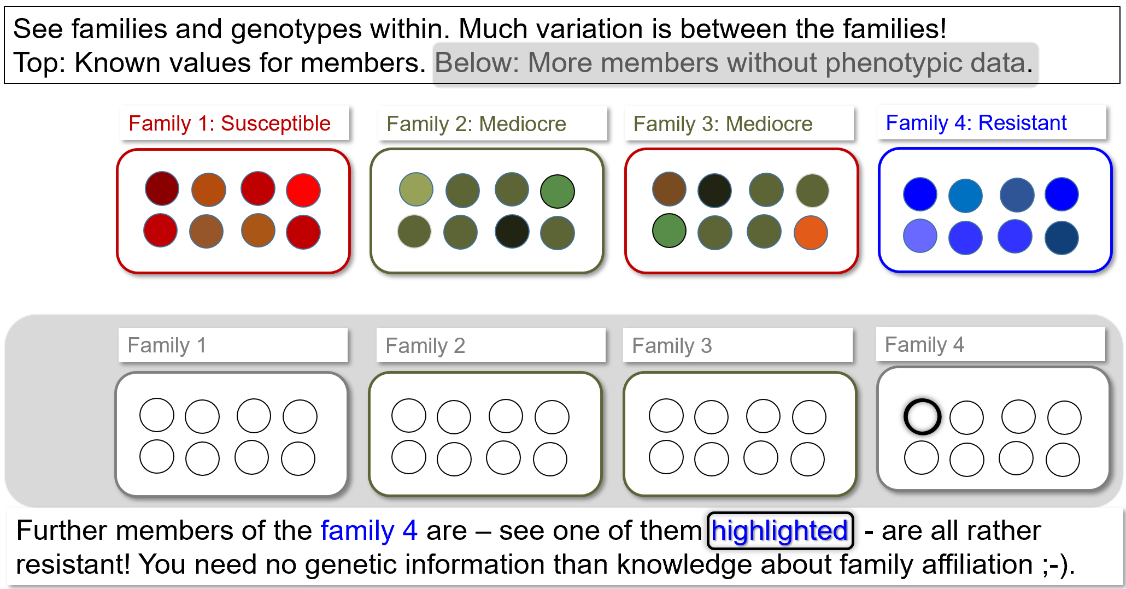
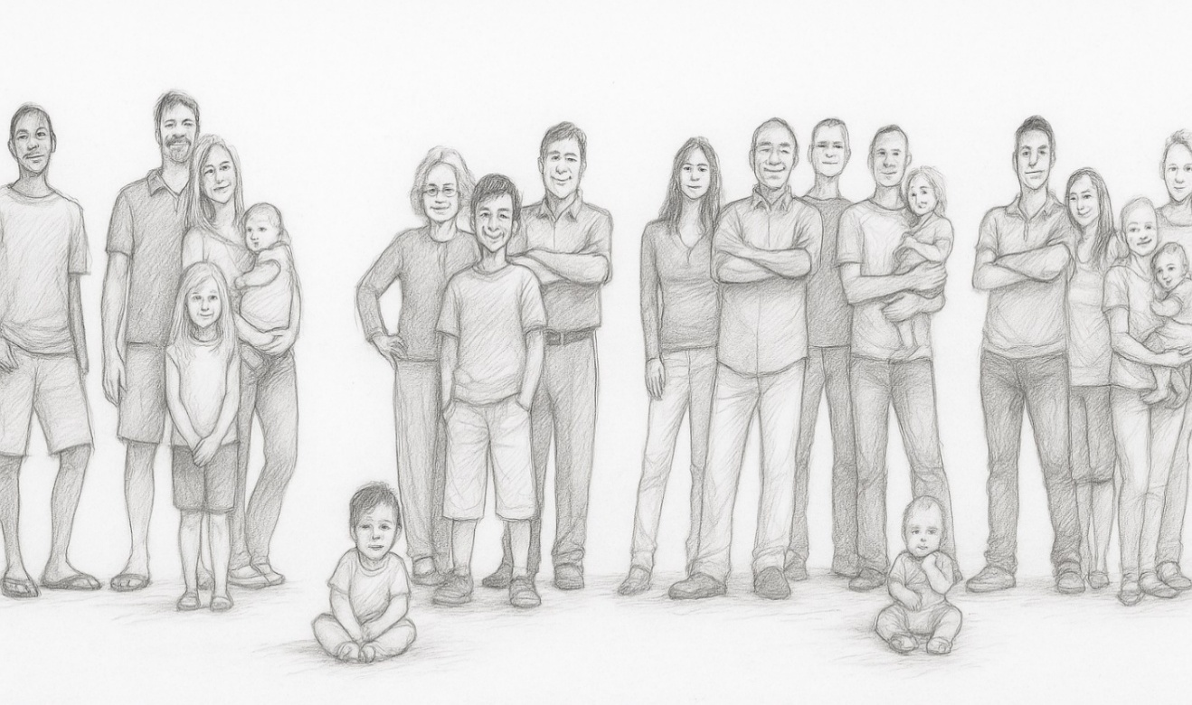
?
Topic: Family affiliation. In case of doubt, a DNA-test will tell (‘Genomic Relationship Matrix’; DOI:10.1038/nrg1960)
If the training population) is composed from distinct groups (shows genetic ‘structure’), then ...
... may be we are able to already make some prediction for non-phenotyped test genotypes: If only you know their pedigree, their belonging to which-of-the groups. If traditional pedigree is not available or doubtful, you reconstruct it from marker data (construct and use the Genomic Relationship Matrix). This is at times even superior to using traditional pedigree data. It works to some extent even if you have no clue about any of the genes in the candidates or any of its QTL alleles or any of its ‘effects’ at its markers.
Obviously, such ‘population structure’ is a normal and frequent case in application of GS. For instance because superior lines are used in several crosses ... – the scenario with one un-structured training population and with a breeding population which is distant and genetically different – this scenario is unrealistic (and obviously unfavou-rable, because the ‘secret’ help provided by relationship-based component of GP would be missing).

Slide 35
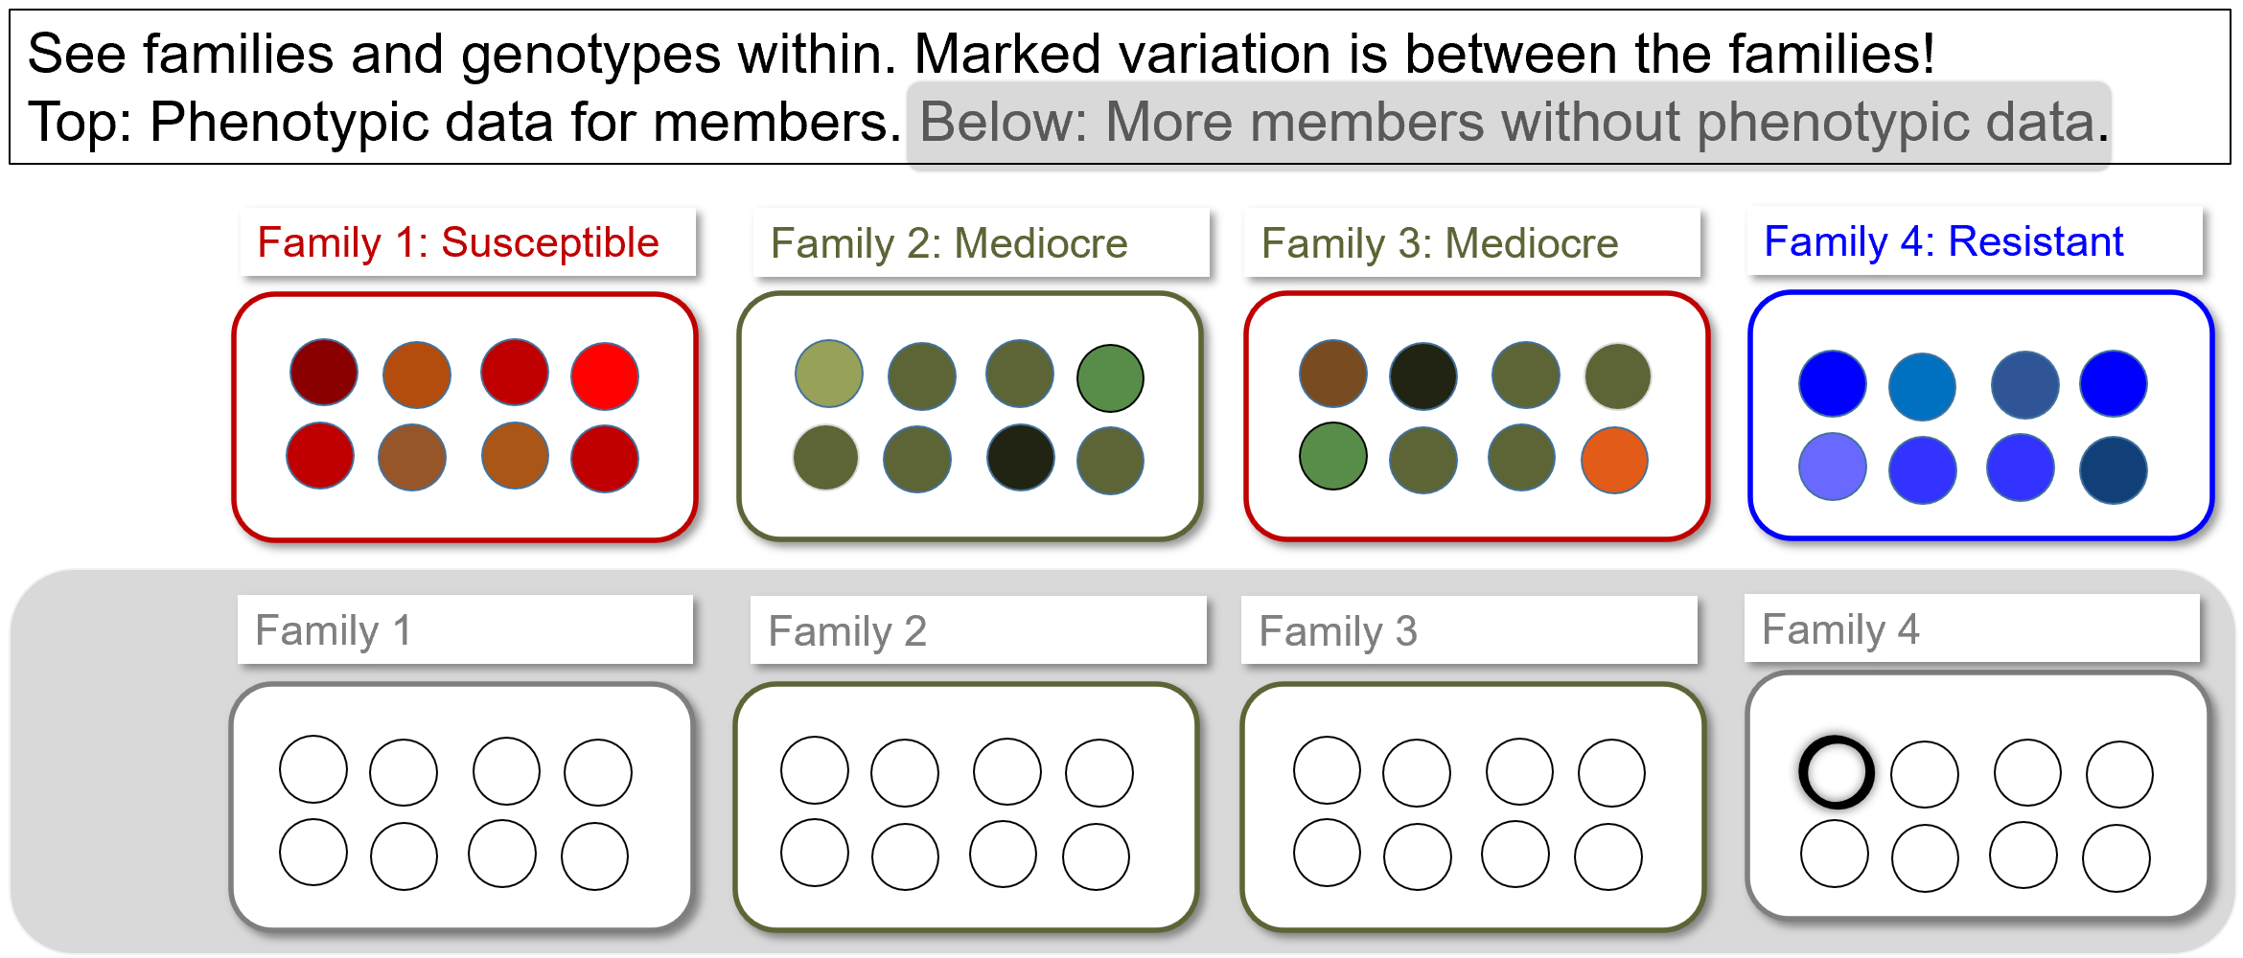
Comments on ➔ SNP-effect based and ➔ GRM-based Genomic Prediction.
Genomic prediction derives power from two fundamentally different sources.
➔ Estimation of Allele Effects
➔ Exploitation of Genetic relationships.
Genetic structure generates predictive ability even when estimates of individual allele effects are uncertain, because we borrow information from genetically related individuals in the training population. This works as long as Training and Test Population are essentially samples from the same basic pool (share common ancestry; genetic structure). This source-of-power is population-specific, not universal. It weakens as the connectedness (match) between training and test population decreases. In contrast, prediction based on causal alleles should be universal*: It does not rely on shared ancestry. With causal marker alleles, prediction based on their effects remains possible even if LD=0
(well, *universal is probably a too big claim, see next pages).
From this perspective, the GRM (Genomic Relationship Matrix) is both a strength and a weakness of Genomic Prediction. It creates and adds to predictive ability by exploiting common population genetic ‘structure’, but it conceals how little may have been learned about the actual causal alleles. Prediction based primarily on genetic structure is effective within a breeding population. Yet, its declines as genetic match between training and test populations declines.
How much of the predictive ability of a GP model originates from learning transferable allele effects?
How much results merely from borrowing information from genetically related individuals?

Slide 36
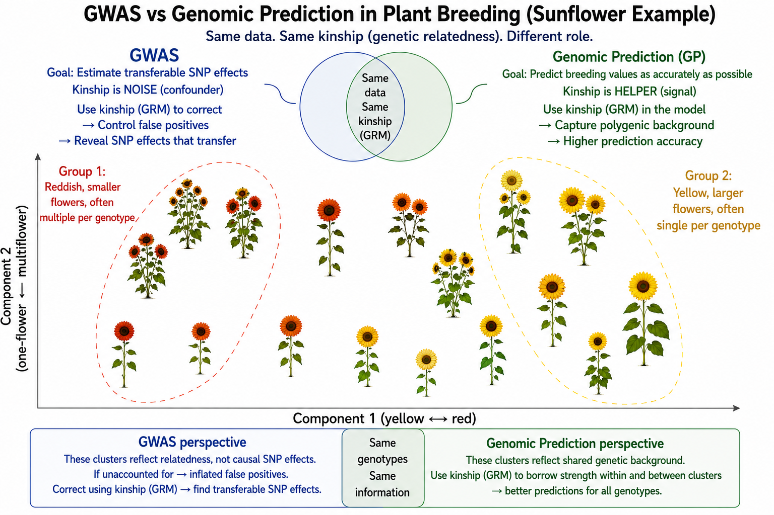
y = Xβ + Zu + e
y = Phenotypic value of trait
X = SNP genotype matrix
Xβ = SNP effects (fixed)
Z = Incidence matrix; links genotypes to Kinship Matrix
Zu = Polygenic background from Kinship (random)
e = residual
Is exploitation of pedigree (or of GRM) rather valuable aid ... or is it more like doping?
X, Z: Design-matrices
β; u: vectors of effects that have to be estimated (training) before employed (prediction)
GWAS: Zu = Noise || GP: Zu = Signal
In ‘ideal’ setting, marker scores from GWAS from all SNP (re-gardless of significance) would show how much of the prediction ability of a GP model is from transferable marker effects vs. how much is via exploitation of Kinship (Genomic Relationship Matrix GRM).

Slide 37
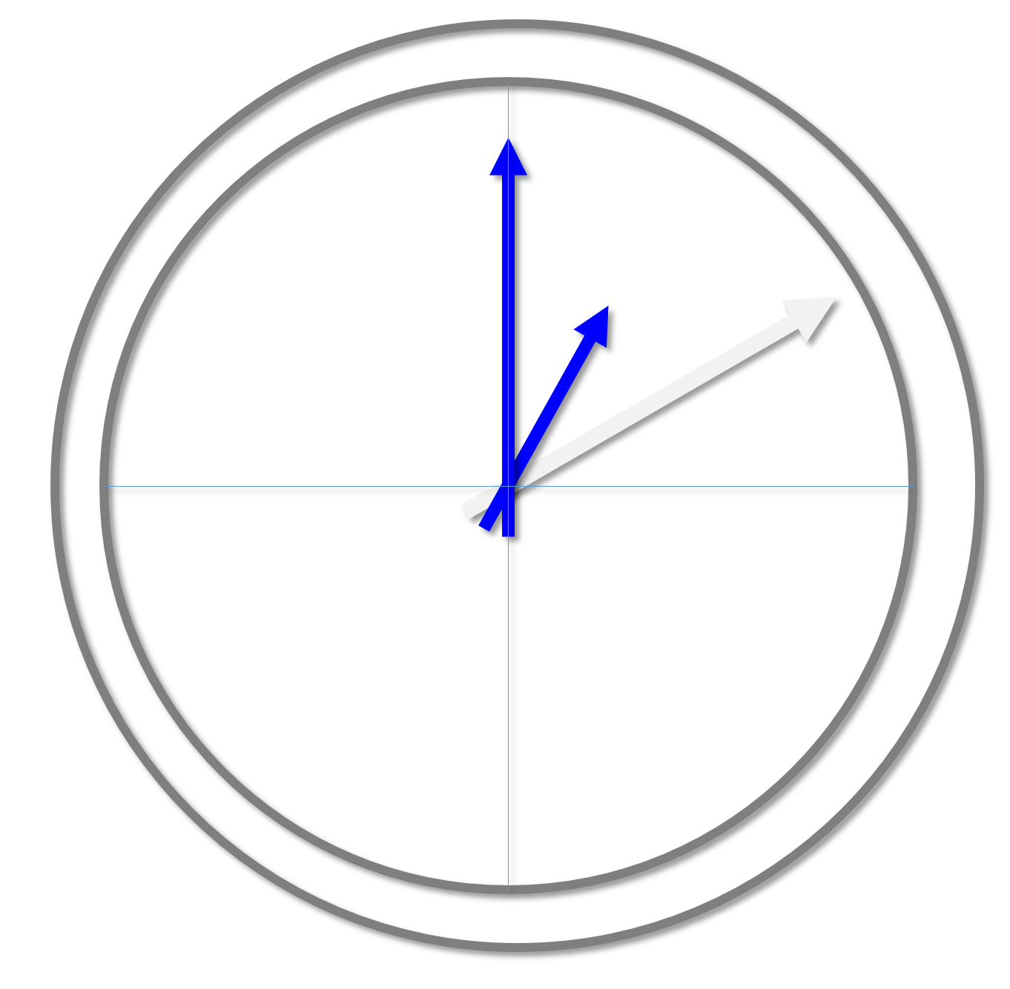
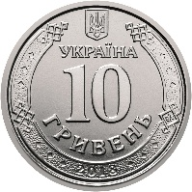
Terms and Purposes of Genomic Prediction (Genomic Selection)
In Genomic Selection, we employ these terms:
Calibration, Training. The Training Population is the set of genotypes which are genotyped (thousands of SNP data per genotype, SNP well-spread across all chromosomes) and phenotyped. The joint analysis to estimate SNP effects on trait expression is the calibration or training (the ‘making’ of GS model; of the algorithm).
Breeding Population is application; in research this is the Test Population in. This is the population of genotype-them-then-predict their performance. Their performance is predicted by applying the GS model. We apply what the mathematical model ‘learnt’ during in the training. The Test population is phenotyped, too. But this is for validation of the model: For research, not for application.
Genomic estimated Breeding Value is the estimated breeding value (from SNP data, using the GS model).
Genomic estimated Genotypic Value. This is same, just pointing to the per se genotypic value of the candidate instead of its Breeding Value. Compare:
UNPLAB-QuGen_Ch6[StatMod I] page ~22.
When applying Genomic Selection, shortening of time in the breeding scheme is the major advantage. Pheno-typic values can be predicted as soon as DNA can be extracted from candidates. No time has to be wasted ‘just‘ to wait for the developmental stage that shows the trait expression or to increase amount of seed to grow decent field plots. Yield can be predicted for any geno-type as soon as it exists at least as seedling (even as unsown seed). The predictive ability (correlation bet-ween the Genomic Predicted Genetic Values and the phenotypic values) are, often low, such as 0.2 < r < 0.5.
But this is weakness is typically more than compensated for: By gain in time. Genomic Prediction is not used to select the ultimately best candidate. It is mainly used to pre-select, to save field testing budget, and to markedly speed up the process of breeding.
37

Slide 38
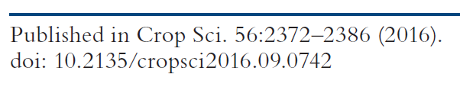
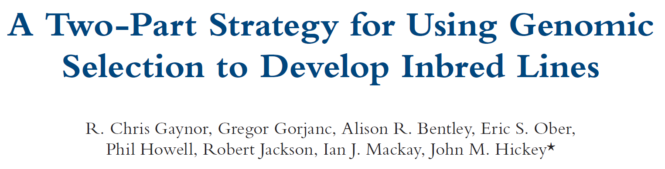
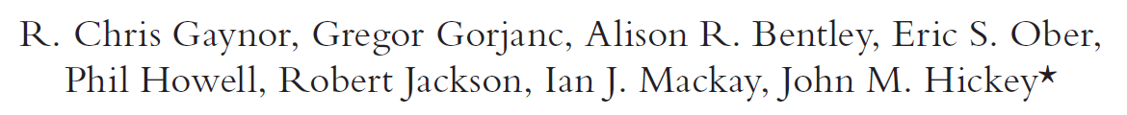
We use now a seminal paper (Gaynor et al.), that allows to (1) show the implementa-tion of Genomic Prediction/Selection in line cultivar development and (2) … more.
The text also shows, among many very instructive insights, that the authors come from animal breeding and mentally have not fully migrated from there into the plant breeding sector - although they report on wheat breeding ;-) “These plants are genotyped, genomic selection is applied, and the best individuals are intercrossed to produce a new generation”. They of course do not want to say “individual” but “genotype” (or candidate or entry or the like). They write “individual” because in animal breeding, genotype and individual is usually synonymous. They do this in that text seven times, and you find this mis-use of “individual” in many other publications on Genomic Selection. Well …
In Plant Breeding, as we saw earlier, we embrace Pre-Breeding and Recurrent selection as well as the honest Cul-tivar Development. And the product, the new (and better) cultivar, is not only a great thing for the farmers, but is also used as a potential, new crossing parent for the breeder who bred it and for her competing breeders. Therefore, breeding means (1) Cultivar Development and (2) Identification of parents for next Crossing (and Breeding) cycle.
The time span from
making the cross until the Farmers sow seed of the new cultivar is longer than from
making the cross until the Breeder identifies superior offspring which is used to start a next cycle of crossing and Breeding. It is the latter, shorter time span length that makes us calculate ‘Gain from selection Per Unit of Time’. Gaynor et al. also address, amongst other ones, this point.
38

Slide 39
This here is the thrilling proposal: The so-called ‘Two-Part-Strategy’
First Part: Recurrent Selection aka
Pre-Breeding
Second Part: Product Development
Interlock Pre-Breeding and Cultivar development more closely than usual, and exert most of the selection pressure in the Pre-Breeding part and lesser in the Making of the cultivar.
Exploit the opportunity for extreme speed and extreme selection intensity in the First Part via single-plant-based Genomic Selection
*Exploit the field plots in the Second Part, to feed new phe-notypic data into the ever-again-improved training, i.e. model-update of GS.
Of course: Apply GS as well in the Second Part.
DH-line breeding
Mass-crossing & recombination, mass-Genomic Selection between very many F1-individuals, 2 gens. per year
*
*Use current phenotypic data to re-train the GS model
Gaynor et al., 2017
39
Notes:
Of x200 half-sib families -> get approx. 600 DH -> not 10,000 as in conventional

Slide 40
This here is the thrilling proposal: The so-called ‘Two-Part-Strategy’
First Part: Recurrent Selection aka
Pre-Breeding
Second Part: Product Development
Interlock Pre-Breeding and Cultivar development more closely than usual, and exert most of the selection pressure in the Pre-Breeding part and lesser in the Making of the cultivar.
Exploit the opportunity for extreme speed and extreme selection intensity in the First Part via single-plant-based Genomic Selection
*Exploit the field plots in the Second Part, to feed new phe-notypic data into the ever-again-improved training, i.e. model-update of GS.
Of course: Apply GS as well in the Second Part.
DH-line breeding
In case you want to follow up ...
DOI 10.1101/2022.12.19.521119
DOI 10.1007/s00122-025-05028-1
DOI 10.21203/rs.3.rs-1246254/v1
Mass-crossing & recombination, mass-Genomic Selection between very many F1-individuals, 2 gens. per year
*
*Use current phenotypic data to re-train the GS model
Gaynor et al., 2017
40
Notes:
Of x200 half-sib families -> get approx. 600 DH -> not 10,000 as in conventional

Slide 41
We have seen Breeding Methods in Line Breeding.
And we have noticed the current status: In addition to phenotype-based selection we employ DNA-marker-based selection.
Not only to follow a monogenic resistance or zero-content of antinutritive compound (or the like) in breeding and back-crossing, but:
● to predict from DNA-data plus knowledge of few, significant QTL the candidates‘ Marker Score (trait expression, performance) … and/or
● to predict from DNA-data and a trained GP-model the candidates‘ ‚Genomic Estimated Breeding/Genotypic Value‘ for the focal trait.
After this we now visit the remaining three Breeding Categories.
41

Slide 42
From here you may go to UNPLAB-BrMeth_Ch-12[TheFour IV]
What did we study in this chapter? Marker-assisted selection (MAS).
Well, not the traditional way, which is like “follow the segregation of one DNA-Marker locus and thus indirectly follow the segregation of one focal locus; of a locus contributing to a trait of interest, to a QTL - provided that your marker locus (is tightly linked and) shows strong LD with that focal locus (at best, the marker locus marks the causal polymorphism in that gene)”.
No. Not that traditional way. Instead, we touched two approaches, GWAS and Genomic Prediction (Genomic Selection). Either, a marker score is built from a (small) number of known, verified, significant QTL-marking DNA-markers. You need to know the marker genotypes (allele-status of each marker) of each candidate, then such marker score ‚predicts‘ their trait values. Or: The marker score is built from all (thousands, >ten-thousands, ...) SNP and their effects (mostly zero or tiny) on the trait variation. With this approach, the marker score is named ‚Genomic Estimated Genetic Value‘ or ‘Genomic Estimated Breeding Value‘ and wants to predict the ‘Total Genetic Value’ of the candidates. There is a ‘hidden helper’ in GP, absent in GWAS: It is the GRM, which allows ‘borrowing’ of information on a candidate from relatives that were (hopefully) available in the training population.
Prediction?! May save money, may save time. Much of all Plant Breeding is ‚prediction‘ anyway.
42

